Slide 1
Walker Water Runoff Challenge
© SRI International, Digital Promise, University of Virginia, Vanderbilt University 2022. This work is licensed under CC BY-NC-SA 4.0 license. To view a copy of this license, visit https://creativecommons.org/licenses/by-nc-sa/4.0/
Notes:
NSF Funded

Slide 2
Activity 1 What problem are we trying to solve?
Walker Water Runoff Project
© SRI International, Digital Promise, University of Virginia, and Vanderbilt University 2022. This work is licensed under CC BY-NC-SA 4.0 license.
To view a copy of this license, visit https://creativecommons.org/licenses/by-nc-sa/4.0/

Slide 3
What is engineering?
© SRI International, Digital Promise, University of Virginia, and Vanderbilt University 2022. This work is licensed under CC BY-NC-SA 4.0 license.
To view a copy of this license, visit https://creativecommons.org/licenses/by-nc-sa/4.0/

Slide 4
What is engineering?
Designing solutions to particular human problems.
© SRI International, Digital Promise, University of Virginia, and Vanderbilt University 2022. This work is licensed under CC BY-NC-SA 4.0 license.
To view a copy of this license, visit https://creativecommons.org/licenses/by-nc-sa/4.0/

Slide 5
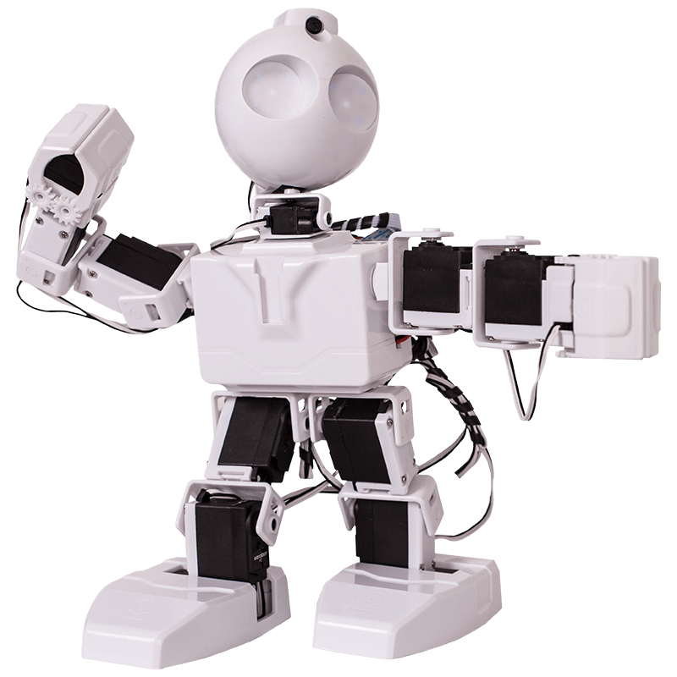
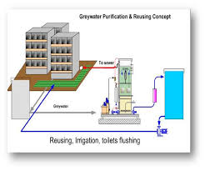
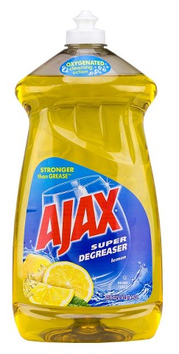
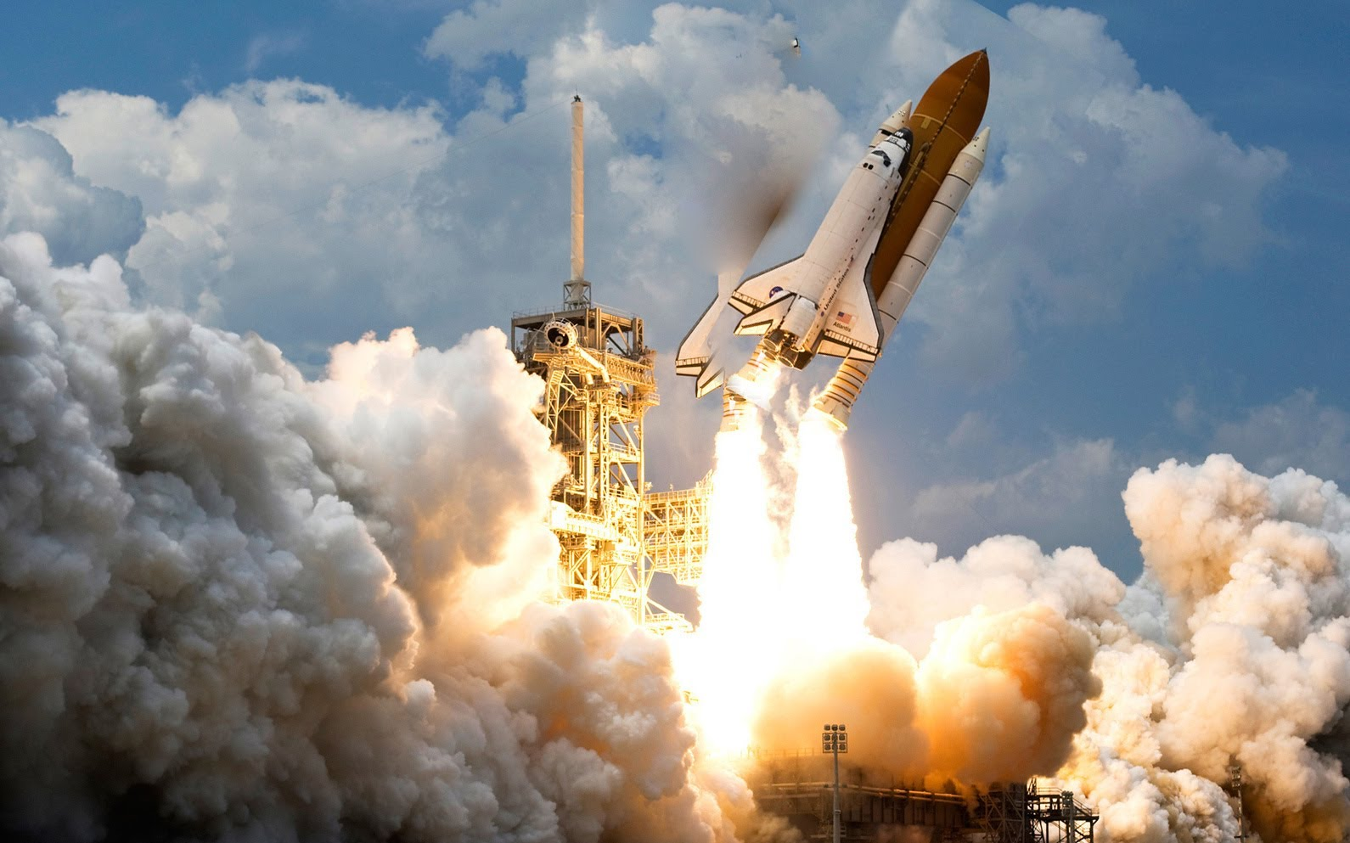
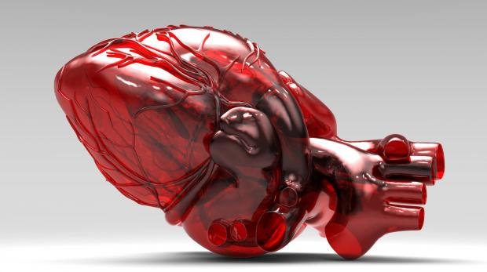
What is engineering?
Not just this: But also this:
© SRI International, Digital Promise, University of Virginia, and Vanderbilt University 2022. This work is licensed under CC BY-NC-SA 4.0 license.
To view a copy of this license, visit https://creativecommons.org/licenses/by-nc-sa/4.0/

Slide 6
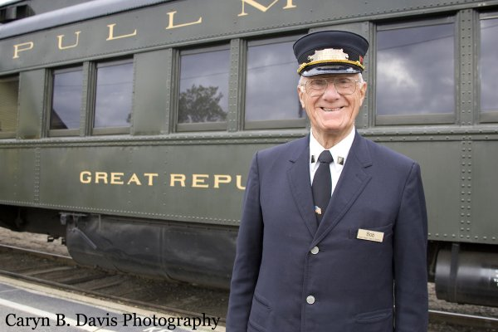
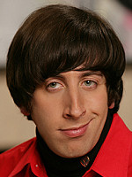
Who are engineers?
MYTHS: Reality:
You!
© SRI International, Digital Promise, University of Virginia, and Vanderbilt University 2022. This work is licensed under CC BY-NC-SA 4.0 license.
To view a copy of this license, visit https://creativecommons.org/licenses/by-nc-sa/4.0/

Slide 7
Engineering Design Process (Map)
© SRI International, Digital Promise, University of Virginia, and Vanderbilt University 2022. This work is licensed under CC BY-NC-SA 4.0 license.
To view a copy of this license, visit https://creativecommons.org/licenses/by-nc-sa/4.0/
Notes:
Beth

Slide 8
What problem are we trying to solve?
Video from Ms. Green
Video of Walker Elementary School
Page 3 of Student Notebook
1.1. What problems are there at Walker Upper Elementary School?
1.2. How do you think Walker’s problems affect the students and teachers?
1.3. How do Walker’s problems impact the environment?
© SRI International, Digital Promise, University of Virginia, and Vanderbilt University 2022. This work is licensed under CC BY-NC-SA 4.0 license.
To view a copy of this license, visit https://creativecommons.org/licenses/by-nc-sa/4.0/

Slide 9
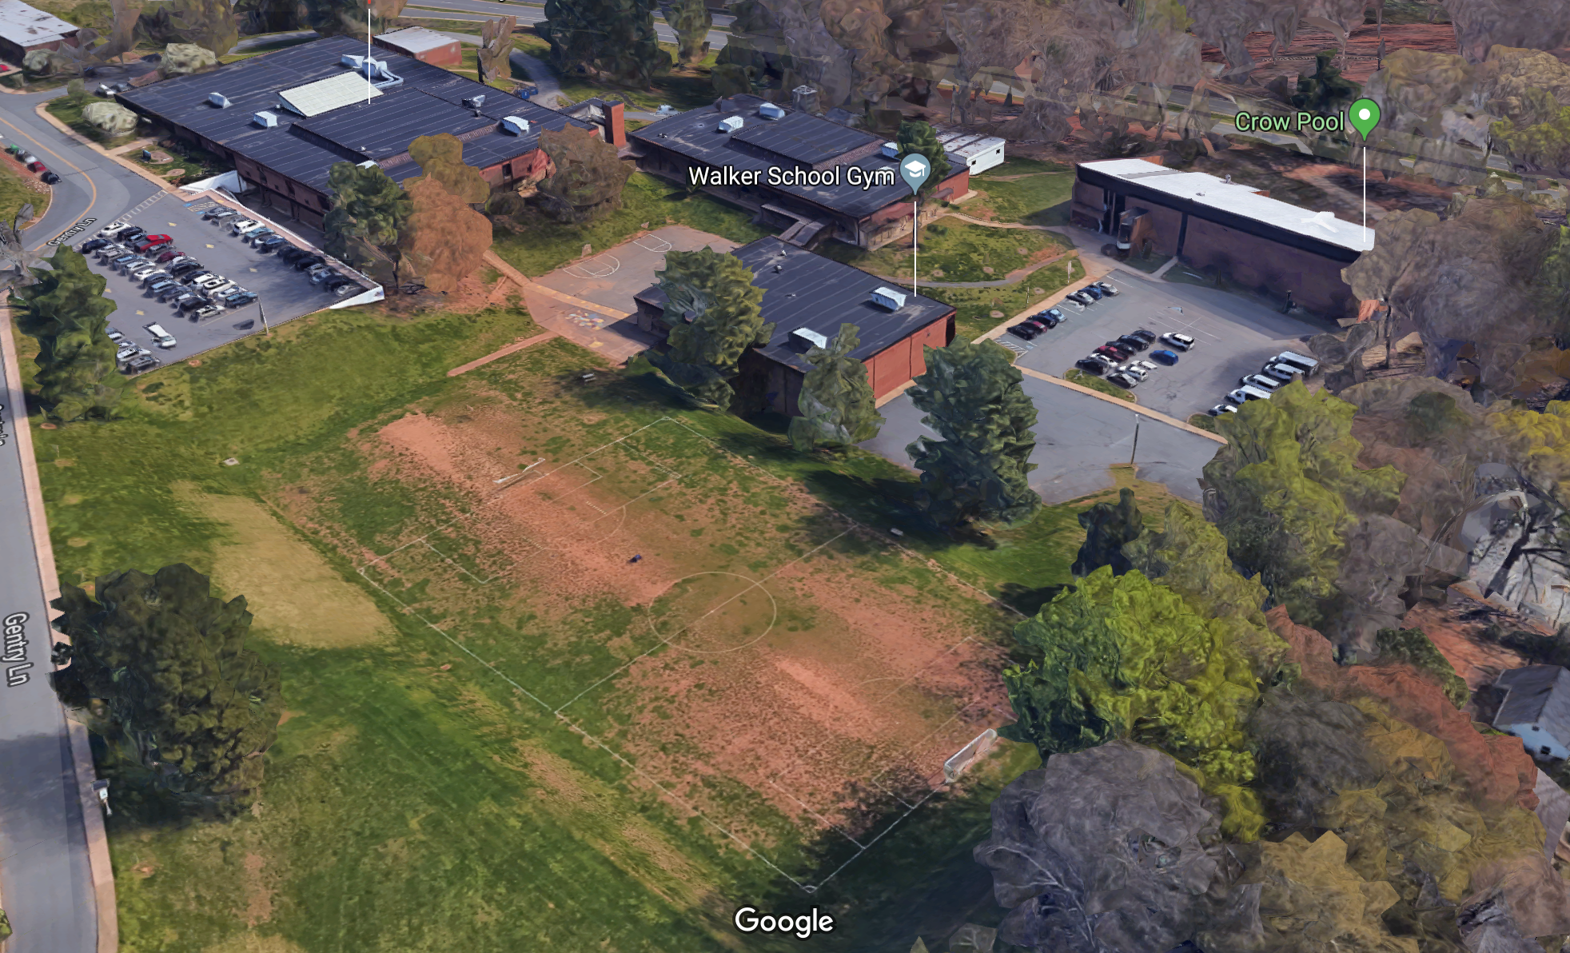
Walker Upper Elementary School
© SRI International, Digital Promise, University of Virginia, and Vanderbilt University 2022. This work is licensed under CC BY-NC-SA 4.0 license.
To view a copy of this license, visit https://creativecommons.org/licenses/by-nc-sa/4.0/
Notes:
What do you notice in this picture?
What are some of the different areas we see in this picture?
Are all the surfaces the same?

Slide 10
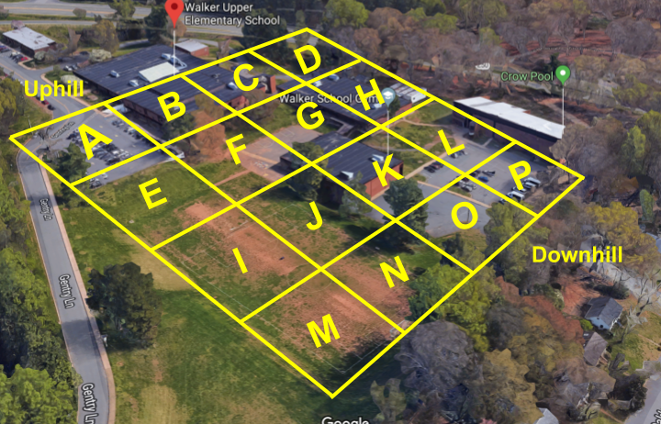
How should the spaces be used?
© SRI International, Digital Promise, University of Virginia, and Vanderbilt University 2022. This work is licensed under CC BY-NC-SA 4.0 license.
To view a copy of this license, visit https://creativecommons.org/licenses/by-nc-sa/4.0/

Slide 11
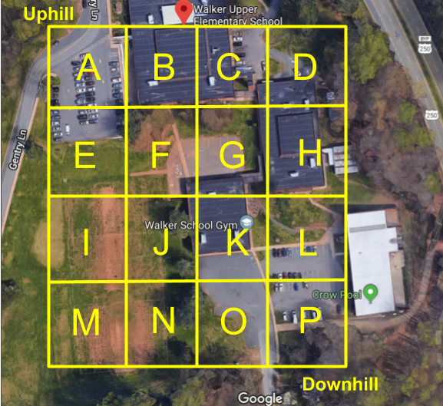
Walker Water Runoff Project
© SRI International, Digital Promise, University of Virginia, and Vanderbilt University 2022. This work is licensed under CC BY-NC-SA 4.0 license.
To view a copy of this license, visit https://creativecommons.org/licenses/by-nc-sa/4.0/
Notes:
Sarah

Slide 12
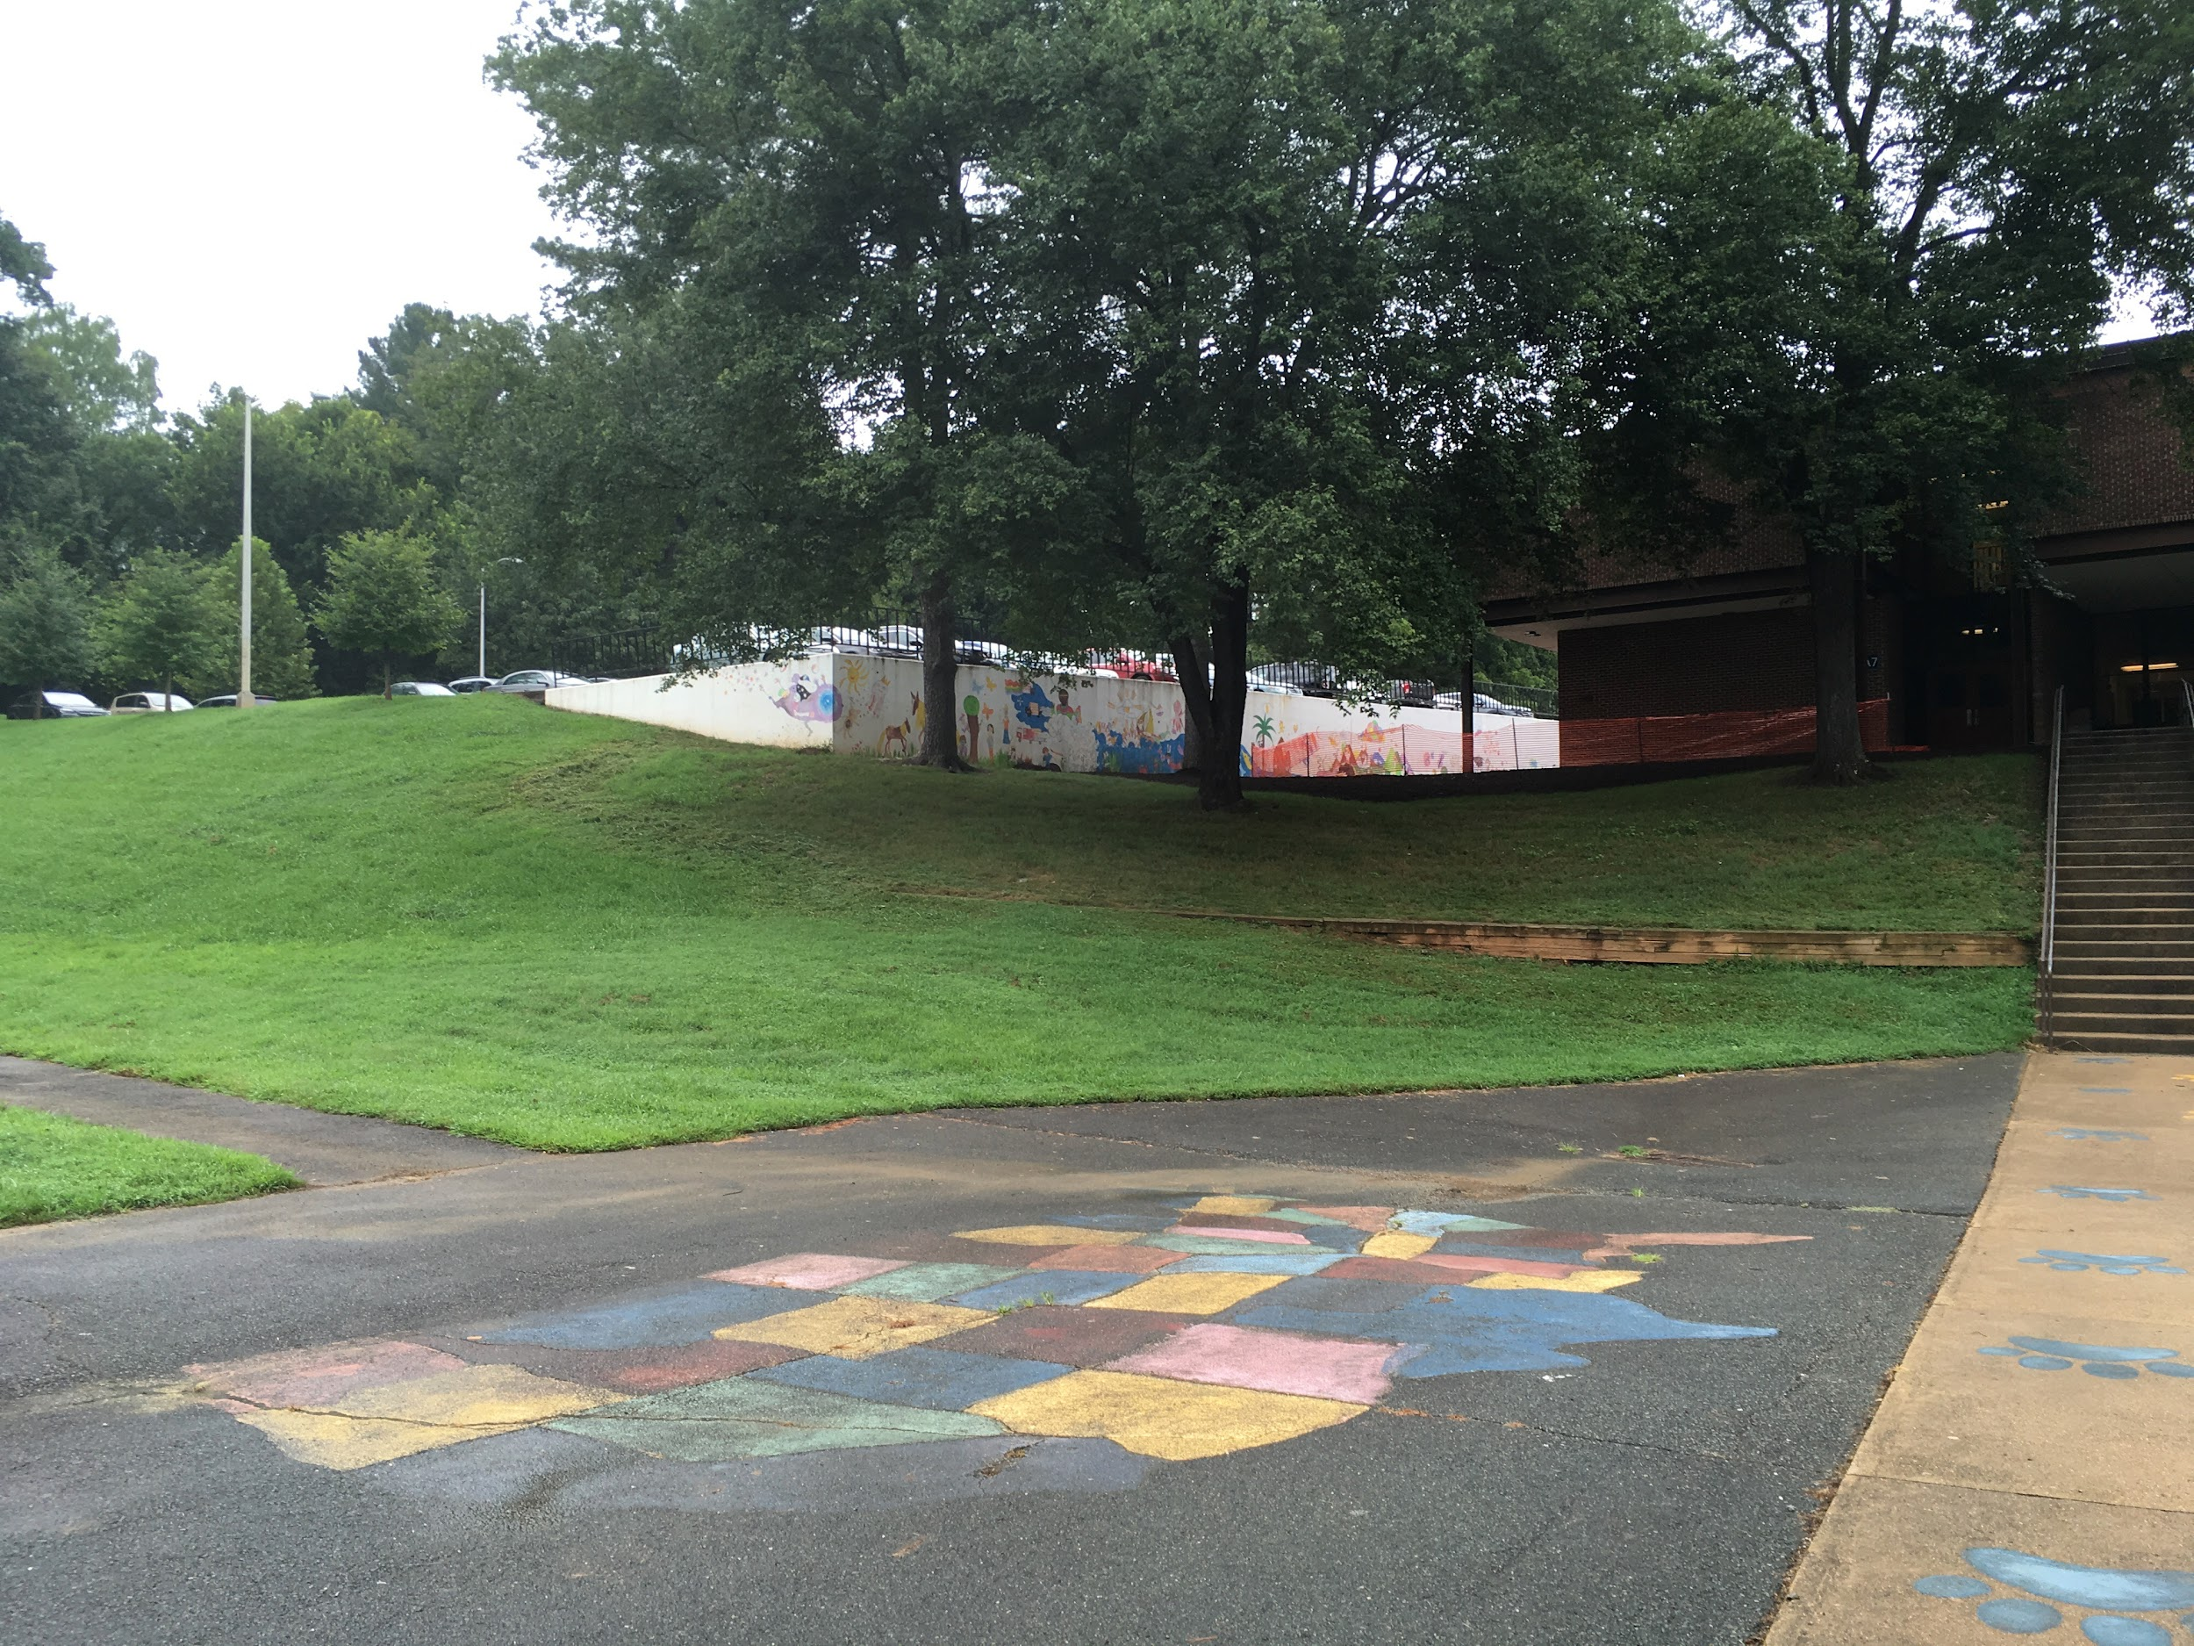
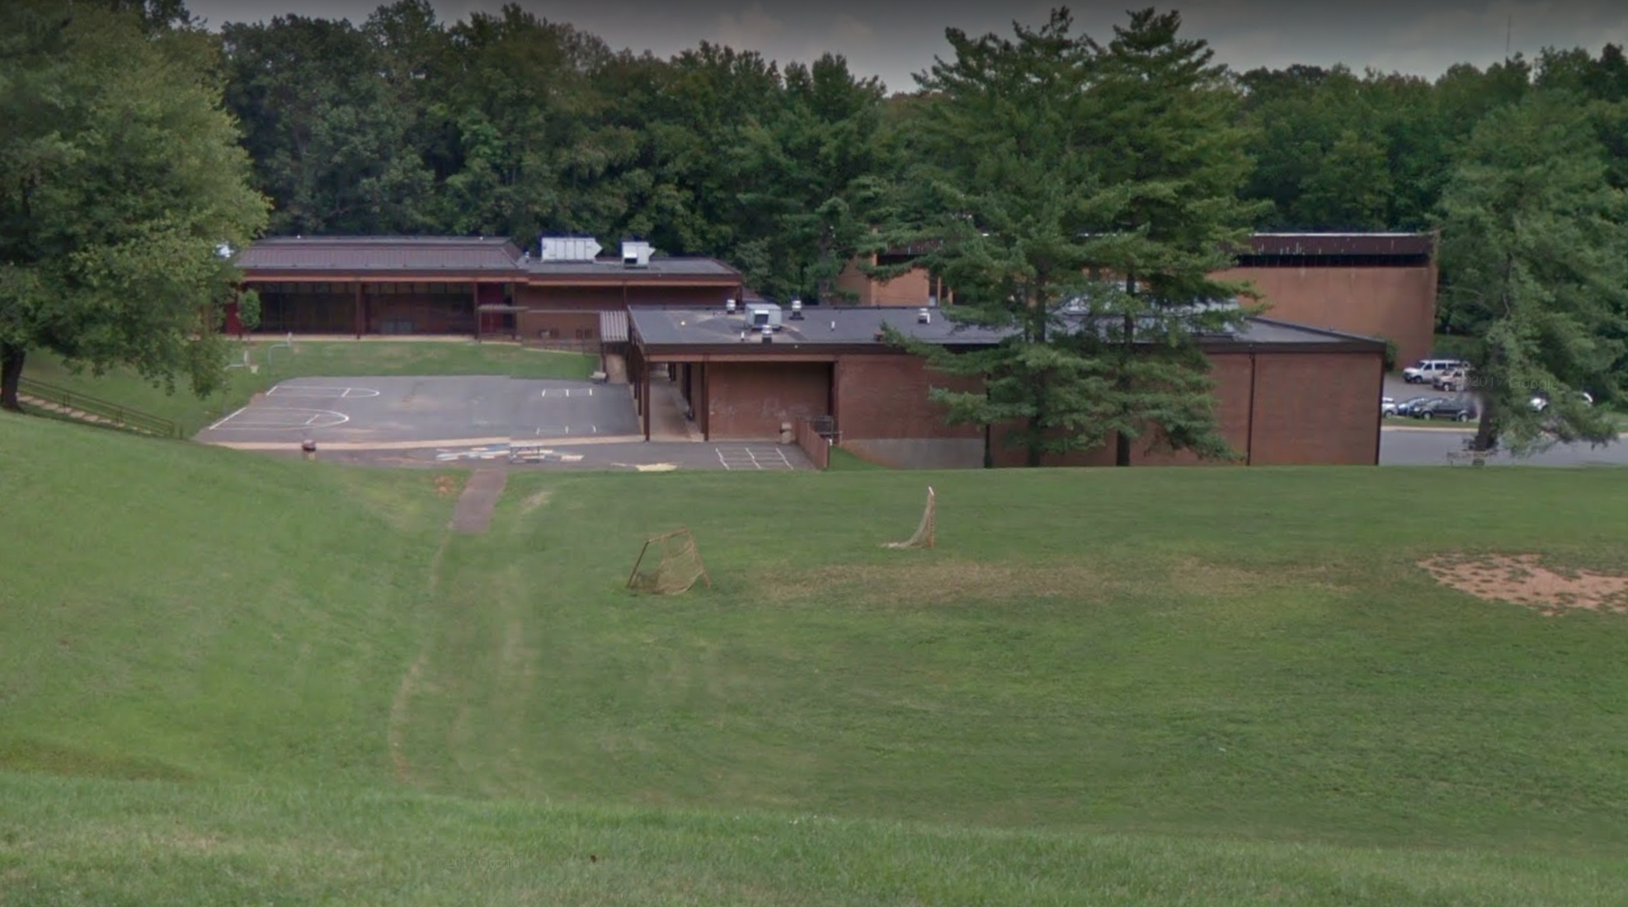
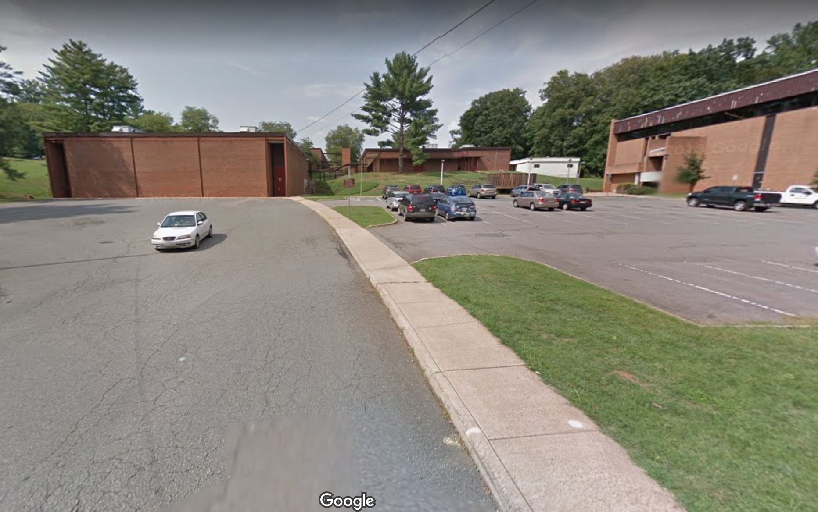
Views of Walker School
© SRI International, Digital Promise, University of Virginia, and Vanderbilt University 2022. This work is licensed under CC BY-NC-SA 4.0 license.
To view a copy of this license, visit https://creativecommons.org/licenses/by-nc-sa/4.0/
Notes:
Sarah

Slide 13
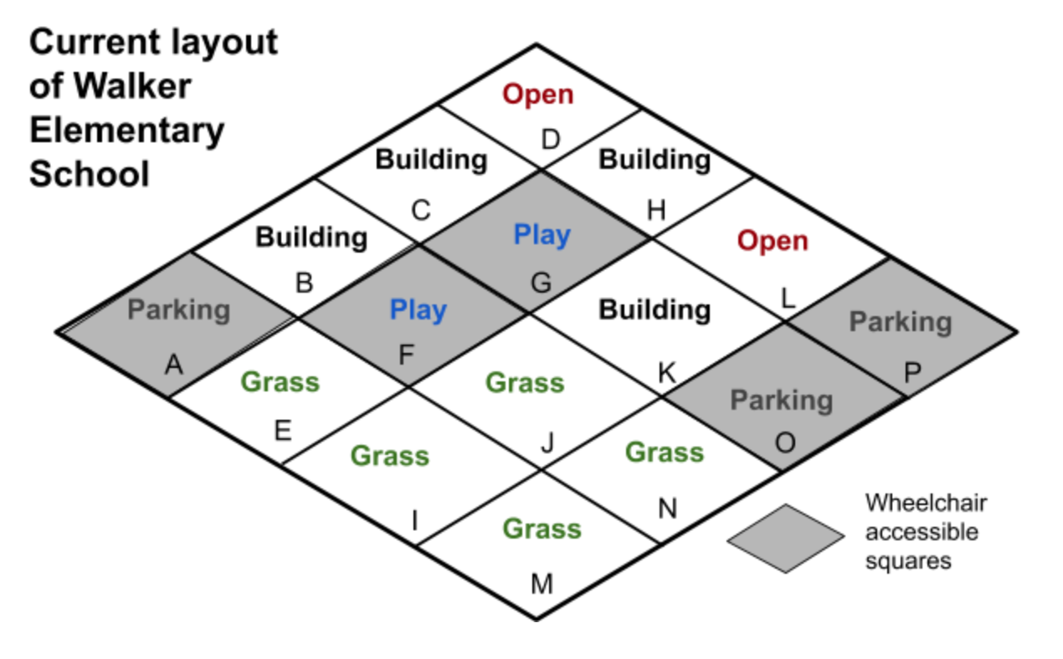
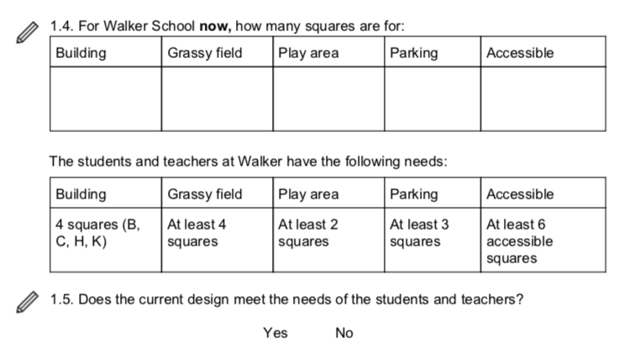
Page 4 of Student Notebook
© SRI International, Digital Promise, University of Virginia, and Vanderbilt University 2022. This work is licensed under CC BY-NC-SA 4.0 license.
To view a copy of this license, visit https://creativecommons.org/licenses/by-nc-sa/4.0/
Notes:
Student notebook p. 4

Slide 14
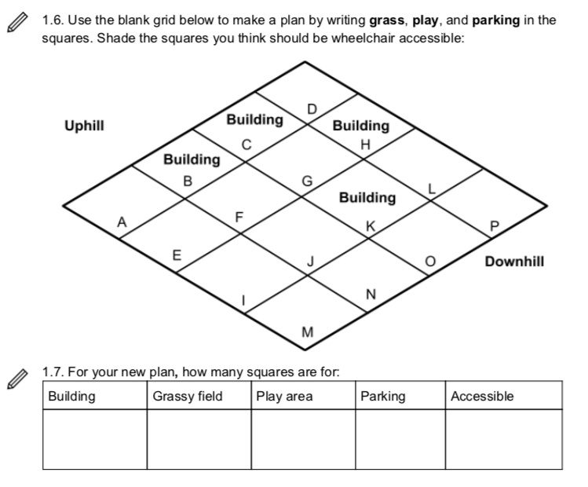
Page 5 of Student Notebook
© SRI International, Digital Promise, University of Virginia, and Vanderbilt University 2022. This work is licensed under CC BY-NC-SA 4.0 license.
To view a copy of this license, visit https://creativecommons.org/licenses/by-nc-sa/4.0/

Slide 15
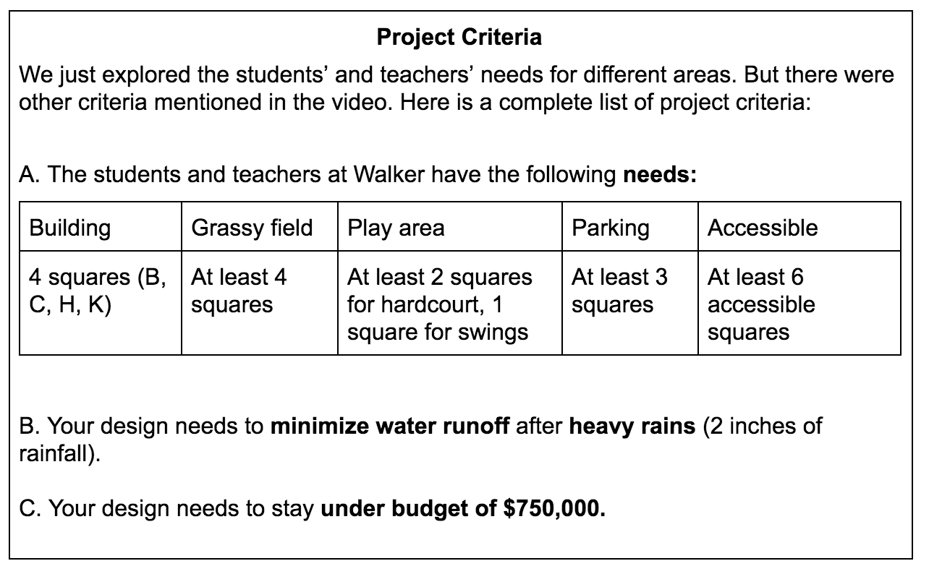
What is the problem we are trying to solve?
© SRI International, Digital Promise, University of Virginia, and Vanderbilt University 2022. This work is licensed under CC BY-NC-SA 4.0 license.
To view a copy of this license, visit https://creativecommons.org/licenses/by-nc-sa/4.0/

Slide 16
Lesson 2:
How much does it rain?
© SRI International, Digital Promise, University of Virginia, and Vanderbilt University 2022. This work is licensed under CC BY-NC-SA 4.0 license.
To view a copy of this license, visit https://creativecommons.org/licenses/by-nc-sa/4.0/

Slide 17
How do we know how much water falls after it rains?
Video of rain in DC and New Orleans
Page 7 of Student Notebook
© SRI International, Digital Promise, University of Virginia, and Vanderbilt University 2022. This work is licensed under CC BY-NC-SA 4.0 license.
To view a copy of this license, visit https://creativecommons.org/licenses/by-nc-sa/4.0/

Slide 18
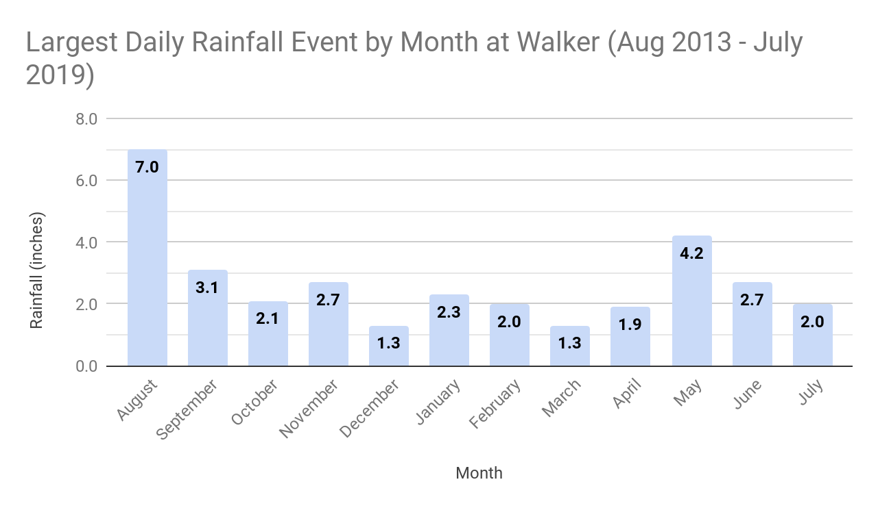
Page 8 of Student Notebook
Looking at the graph:
Which month(s) had the largest one-day rainfall? ____________________
Which month(s) had the smallest one-day rainfall? ____________________
B. If your design is built for a heavy storm of 2 inches, how many months have rainfall events 2 inches or more?____________________
C. How many months have rainfall events under 2 inches?____________________
2.3. Why do you think you need to design for at least 2 inches of rainfall?
Your design must reduce water runoff after a heavy storm that rains at least 2 inches.
© SRI International, Digital Promise, University of Virginia, and Vanderbilt University 2022. This work is licensed under CC BY-NC-SA 4.0 license.
To view a copy of this license, visit https://creativecommons.org/licenses/by-nc-sa/4.0/

Slide 19
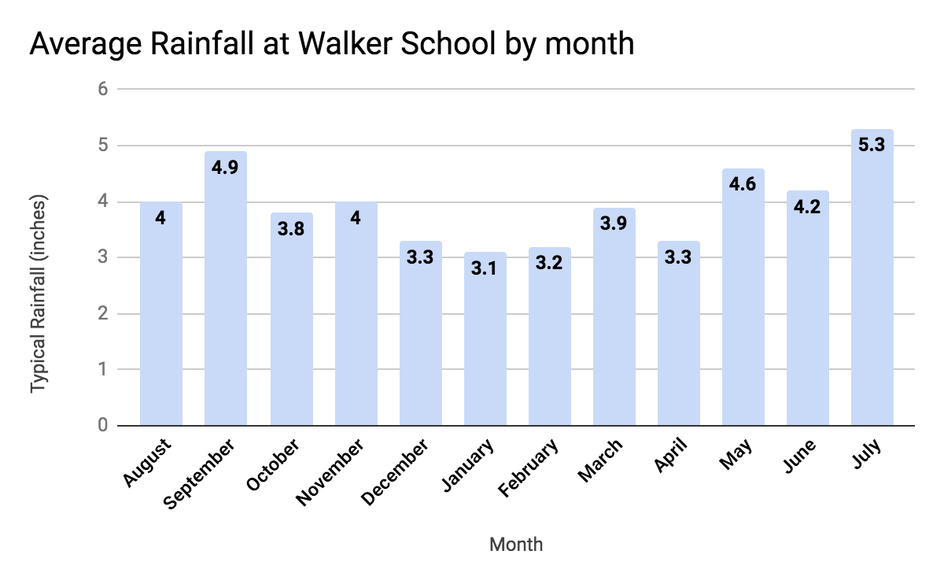
© SRI International, Digital Promise, University of Virginia, and Vanderbilt University 2022. This work is licensed under CC BY-NC-SA 4.0 license.
To view a copy of this license, visit https://creativecommons.org/licenses/by-nc-sa/4.0/
Notes:
(Optional Slide) This slide is optional - it has average rainfall, different than what it is in the student notebook. If you think your students will have difficulty with averages versus total amounts, you can skip this slide.

Slide 20
Why do you think we need to design for 2 inches of rainfall?
© SRI International, Digital Promise, University of Virginia, and Vanderbilt University 2022. This work is licensed under CC BY-NC-SA 4.0 license.
To view a copy of this license, visit https://creativecommons.org/licenses/by-nc-sa/4.0/

Slide 21
Lesson 3:
Where does the rain go?
© SRI International, Digital Promise, University of Virginia, and Vanderbilt University 2022. This work is licensed under CC BY-NC-SA 4.0 license.
To view a copy of this license, visit https://creativecommons.org/licenses/by-nc-sa/4.0/

Slide 22
When it rains, where does the rain go?
When was the last time that it rained?
What do you remember?
© SRI International, Digital Promise, University of Virginia, and Vanderbilt University 2022. This work is licensed under CC BY-NC-SA 4.0 license.
To view a copy of this license, visit https://creativecommons.org/licenses/by-nc-sa/4.0/

Slide 23
Draw a prediction of where rain goes
Page 9 of Student Notebook
© SRI International, Digital Promise, University of Virginia, and Vanderbilt University 2022. This work is licensed under CC BY-NC-SA 4.0 license.
To view a copy of this license, visit https://creativecommons.org/licenses/by-nc-sa/4.0/

Slide 24
Let’s go outside and make it rain!
Each group will need:
Bucket filled with water
Small cup
Notebook and pencil
We are going to pour water on different surfaces and make observations. What should we look for?
© SRI International, Digital Promise, University of Virginia, and Vanderbilt University 2022. This work is licensed under CC BY-NC-SA 4.0 license.
To view a copy of this license, visit https://creativecommons.org/licenses/by-nc-sa/4.0/

Slide 25
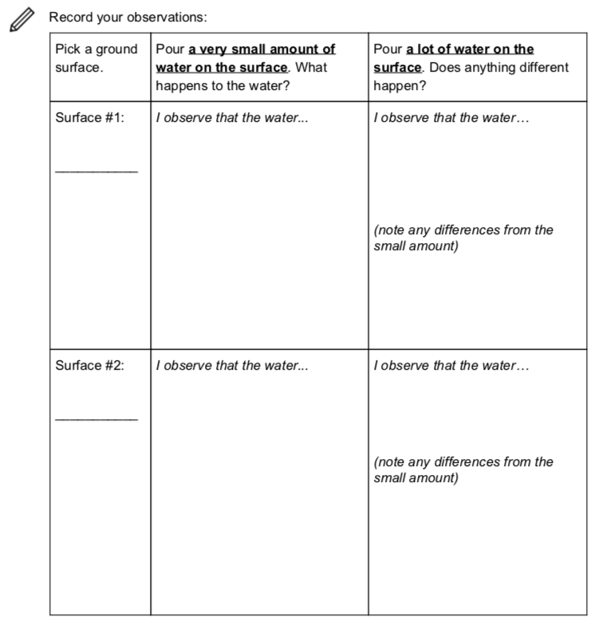
Observations
Page 10 of Student Notebook
© SRI International, Digital Promise, University of Virginia, and Vanderbilt University 2022. This work is licensed under CC BY-NC-SA 4.0 license.
To view a copy of this license, visit https://creativecommons.org/licenses/by-nc-sa/4.0/

Slide 26
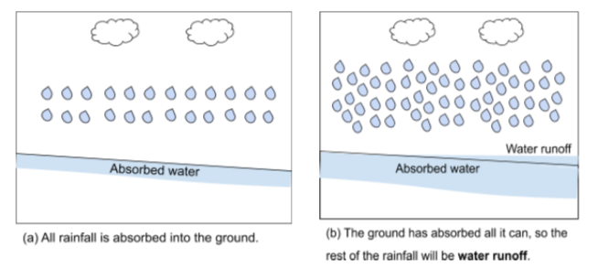
What is water runoff?
Page 12 of Student Notebook
You need to reduce water runoff at Walker. Every surface material can absorb different amounts of water. If the total rainfall is more than the surface can absorb, the rest of the water stays on the surface and runs off downhill. We call this water runoff.
© SRI International, Digital Promise, University of Virginia, and Vanderbilt University 2022. This work is licensed under CC BY-NC-SA 4.0 license.
To view a copy of this license, visit https://creativecommons.org/licenses/by-nc-sa/4.0/

Slide 27
Revise your drawing in 3.1
Page 12 of Student Notebook
© SRI International, Digital Promise, University of Virginia, and Vanderbilt University 2022. This work is licensed under CC BY-NC-SA 4.0 license.
To view a copy of this license, visit https://creativecommons.org/licenses/by-nc-sa/4.0/

Slide 28
How is your new picture different from what you predicted?
Page 12 of Student Notebook
© SRI International, Digital Promise, University of Virginia, and Vanderbilt University 2022. This work is licensed under CC BY-NC-SA 4.0 license.
To view a copy of this license, visit https://creativecommons.org/licenses/by-nc-sa/4.0/

Slide 29
Lesson 4:
How can we make a model of water runoff?
© SRI International, Digital Promise, University of Virginia, and Vanderbilt University 2022. This work is licensed under CC BY-NC-SA 4.0 license.
To view a copy of this license, visit https://creativecommons.org/licenses/by-nc-sa/4.0/

Slide 30
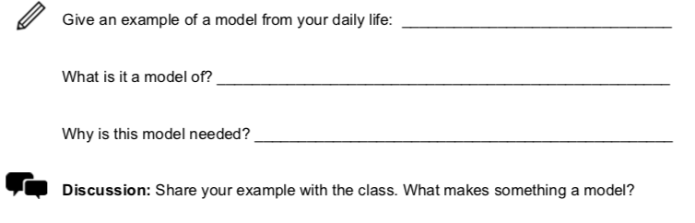
What is a model?
Page 13 of Student Notebook
© SRI International, Digital Promise, University of Virginia, and Vanderbilt University 2022. This work is licensed under CC BY-NC-SA 4.0 license.
To view a copy of this license, visit https://creativecommons.org/licenses/by-nc-sa/4.0/

Slide 31
4.2. Models in science
Page 13 of Student Notebook
© SRI International, Digital Promise, University of Virginia, and Vanderbilt University 2022. This work is licensed under CC BY-NC-SA 4.0 license.
To view a copy of this license, visit https://creativecommons.org/licenses/by-nc-sa/4.0/

Slide 32
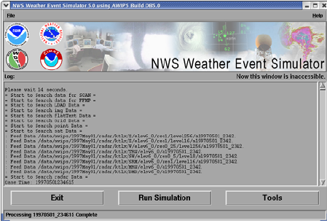
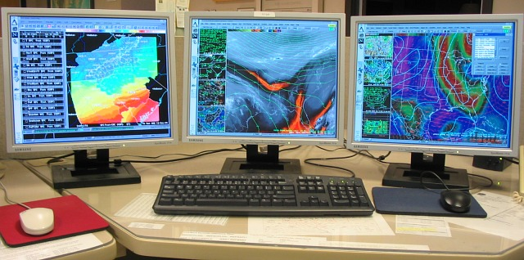
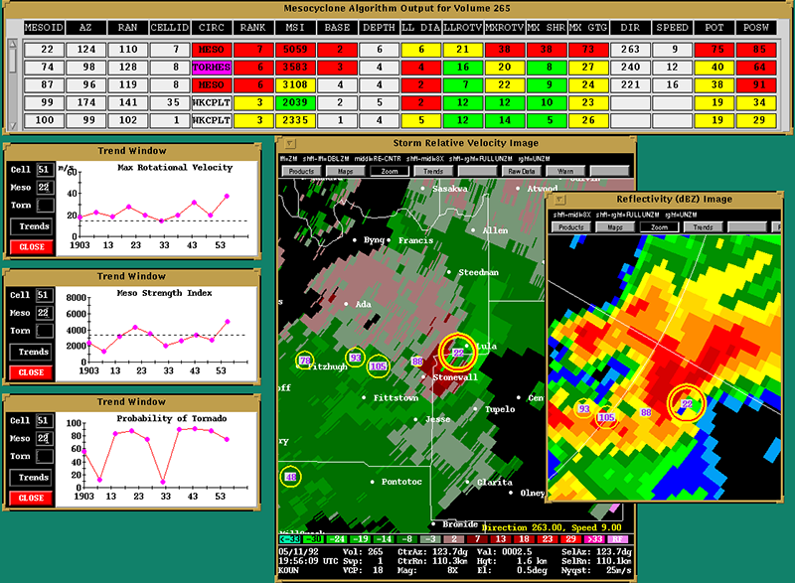
Computer Models & Simulations for Weather Prediction
Walker Water Runoff Project
© SRI International, Digital Promise, University of Virginia, and Vanderbilt University 2022. This work is licensed under CC BY-NC-SA 4.0 license.
To view a copy of this license, visit https://creativecommons.org/licenses/by-nc-sa/4.0/

Slide 33
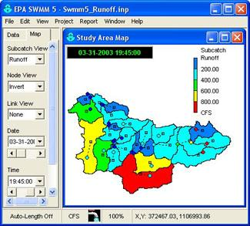
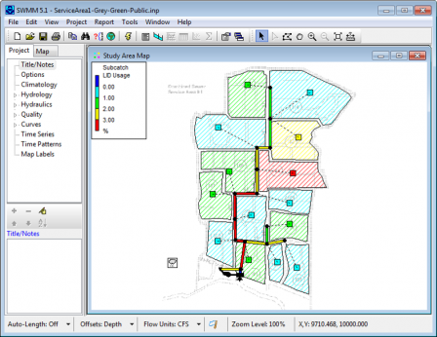
Computer Models for Runoff
Walker Water Runoff Project
© SRI International, Digital Promise, University of Virginia, and Vanderbilt University 2022. This work is licensed under CC BY-NC-SA 4.0 license.
To view a copy of this license, visit https://creativecommons.org/licenses/by-nc-sa/4.0/
Notes:
These are models the EPA uses to calculate stormwater runoff.

Slide 34
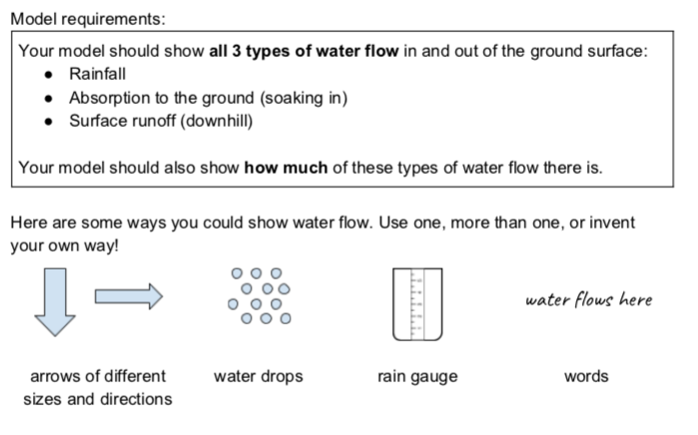
4.3. Draw a runoff model
Page 14 of Student Notebook
© SRI International, Digital Promise, University of Virginia, and Vanderbilt University 2022. This work is licensed under CC BY-NC-SA 4.0 license.
To view a copy of this license, visit https://creativecommons.org/licenses/by-nc-sa/4.0/

Slide 35
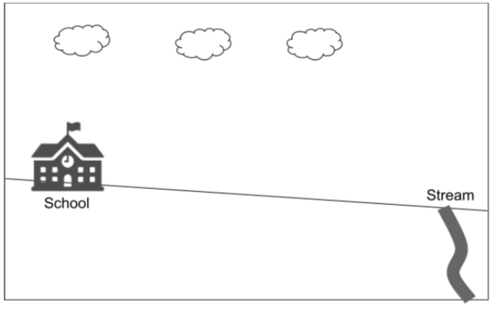
Draw a model of where and how much water flows
Page 14 of Student Notebook
© SRI International, Digital Promise, University of Virginia, and Vanderbilt University 2022. This work is licensed under CC BY-NC-SA 4.0 license.
To view a copy of this license, visit https://creativecommons.org/licenses/by-nc-sa/4.0/

Slide 36
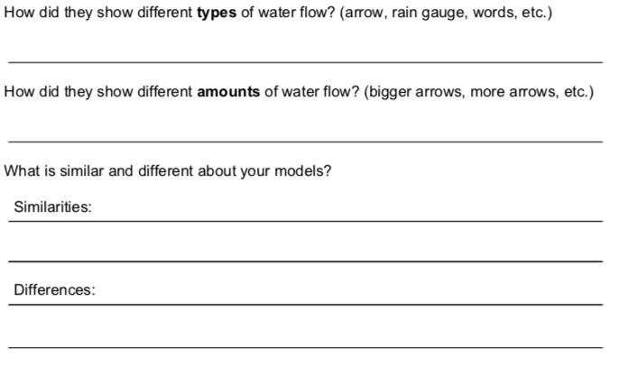
4.4. Compare models
Page 15 of Student Notebook
Find a partner and compare your models.
© SRI International, Digital Promise, University of Virginia, and Vanderbilt University 2022. This work is licensed under CC BY-NC-SA 4.0 license.
To view a copy of this license, visit https://creativecommons.org/licenses/by-nc-sa/4.0/

Slide 37
4.5. Improve your model.
Page 15 of Student Notebook
Based on what you saw in other students’ models, update your model
© SRI International, Digital Promise, University of Virginia, and Vanderbilt University 2022. This work is licensed under CC BY-NC-SA 4.0 license.
To view a copy of this license, visit https://creativecommons.org/licenses/by-nc-sa/4.0/

Slide 38
Closing Discussion
What are the best ways to show how water flows? What are we including in our model? What are we leaving out?
© SRI International, Digital Promise, University of Virginia, and Vanderbilt University 2022. This work is licensed under CC BY-NC-SA 4.0 license.
To view a copy of this license, visit https://creativecommons.org/licenses/by-nc-sa/4.0/

Slide 39
Lesson 5:
How can our model help us predict the amount of water runoff?
© SRI International, Digital Promise, University of Virginia, and Vanderbilt University 2022. This work is licensed under CC BY-NC-SA 4.0 license.
To view a copy of this license, visit https://creativecommons.org/licenses/by-nc-sa/4.0/

Slide 40
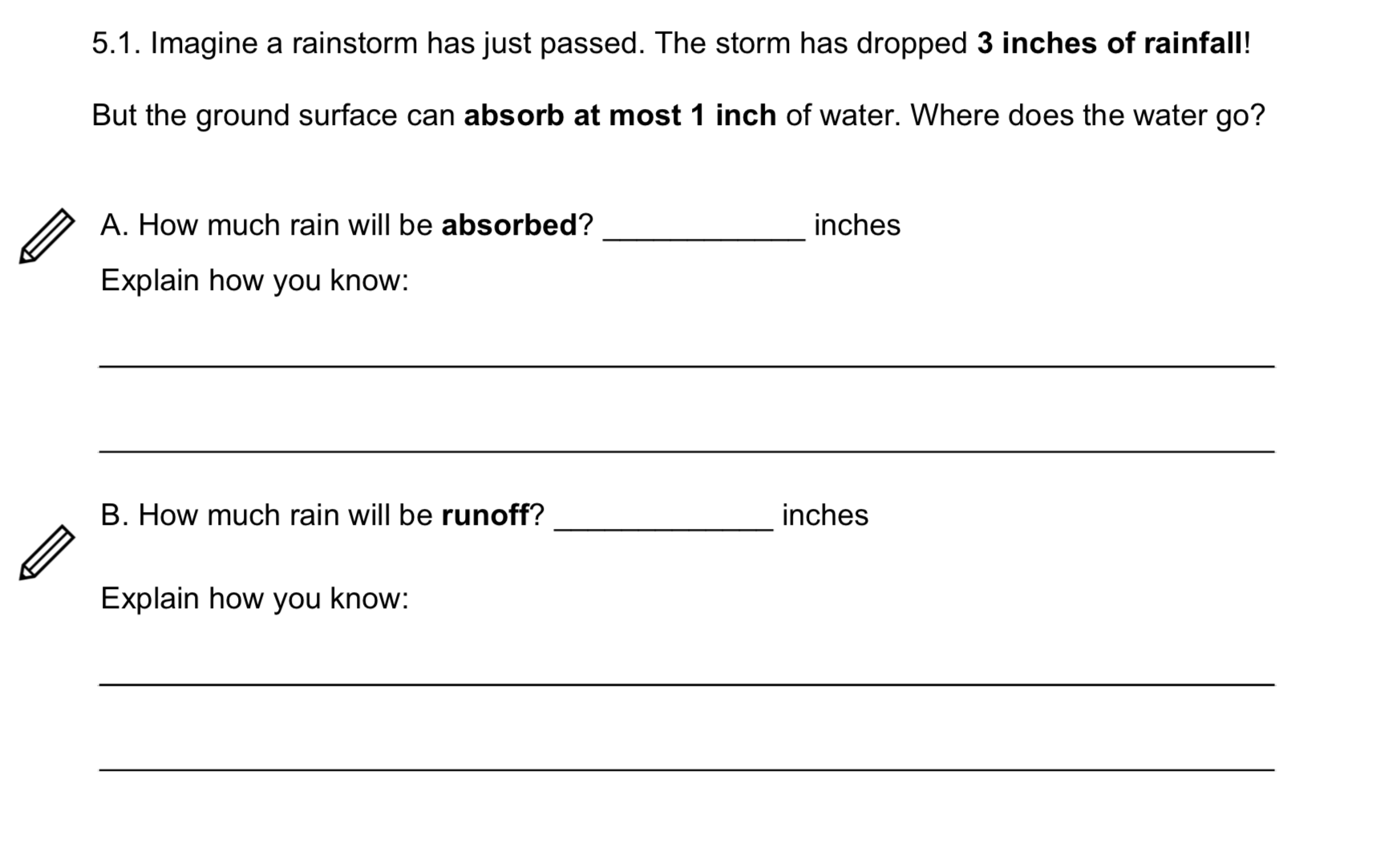
Page 16 of Student Notebook
© SRI International, Digital Promise, University of Virginia, and Vanderbilt University 2022. This work is licensed under CC BY-NC-SA 4.0 license.
To view a copy of this license, visit https://creativecommons.org/licenses/by-nc-sa/4.0/

Slide 41
Absorption Limit
Page 16 of Student Notebook
The most amount of water a surface material can absorb is called the
absorption limit.
If the rainfall is more than the absorption limit, the rest of the water stays on the surface and becomes runoff.
© SRI International, Digital Promise, University of Virginia, and Vanderbilt University 2022. This work is licensed under CC BY-NC-SA 4.0 license.
To view a copy of this license, visit https://creativecommons.org/licenses/by-nc-sa/4.0/

Slide 42
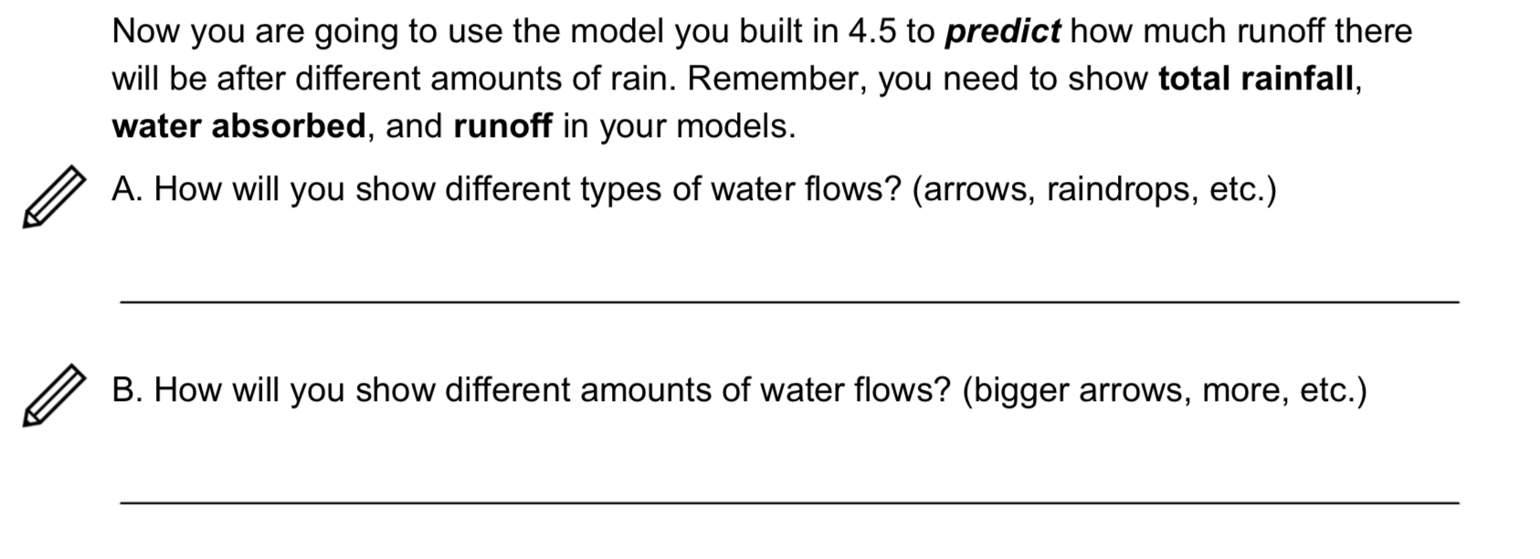
5.2. Predicting water runoff
Page 17 of Student Notebook
© SRI International, Digital Promise, University of Virginia, and Vanderbilt University 2022. This work is licensed under CC BY-NC-SA 4.0 license.
To view a copy of this license, visit https://creativecommons.org/licenses/by-nc-sa/4.0/

Slide 43
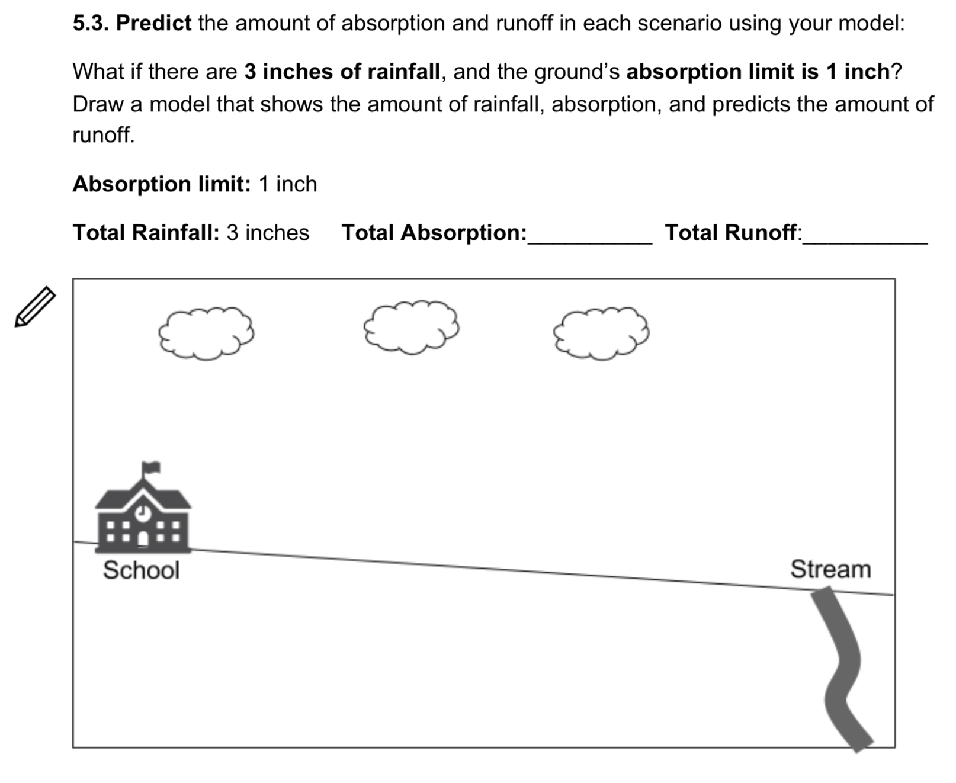
Page 17 of Student Notebook
© SRI International, Digital Promise, University of Virginia, and Vanderbilt University 2022. This work is licensed under CC BY-NC-SA 4.0 license.
To view a copy of this license, visit https://creativecommons.org/licenses/by-nc-sa/4.0/

Slide 44
5.7. Closing Question: ​How can you predict the total runoff if you know the total rainfall and the absorption limit?
© SRI International, Digital Promise, University of Virginia, and Vanderbilt University 2022. This work is licensed under CC BY-NC-SA 4.0 license.
To view a copy of this license, visit https://creativecommons.org/licenses/by-nc-sa/4.0/

Slide 45
Lesson 6:
How can we design Walker to reduce water runoff?
© SRI International, Digital Promise, University of Virginia, and Vanderbilt University 2022. This work is licensed under CC BY-NC-SA 4.0 license.
To view a copy of this license, visit https://creativecommons.org/licenses/by-nc-sa/4.0/

Slide 46
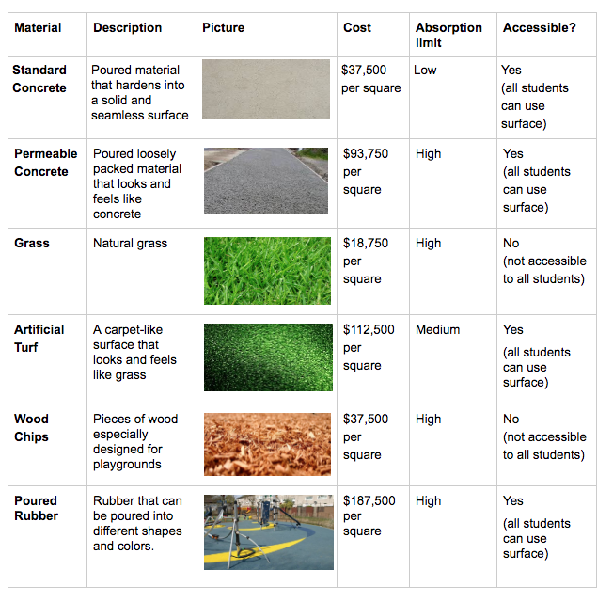
What materials have you seen before?
What materials are best for different needs?
© SRI International, Digital Promise, University of Virginia, and Vanderbilt University 2022. This work is licensed under CC BY-NC-SA 4.0 license.
To view a copy of this license, visit https://creativecommons.org/licenses/by-nc-sa/4.0/

Slide 47
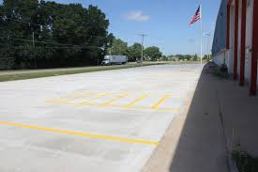
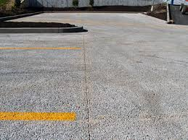
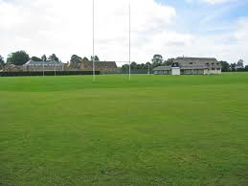
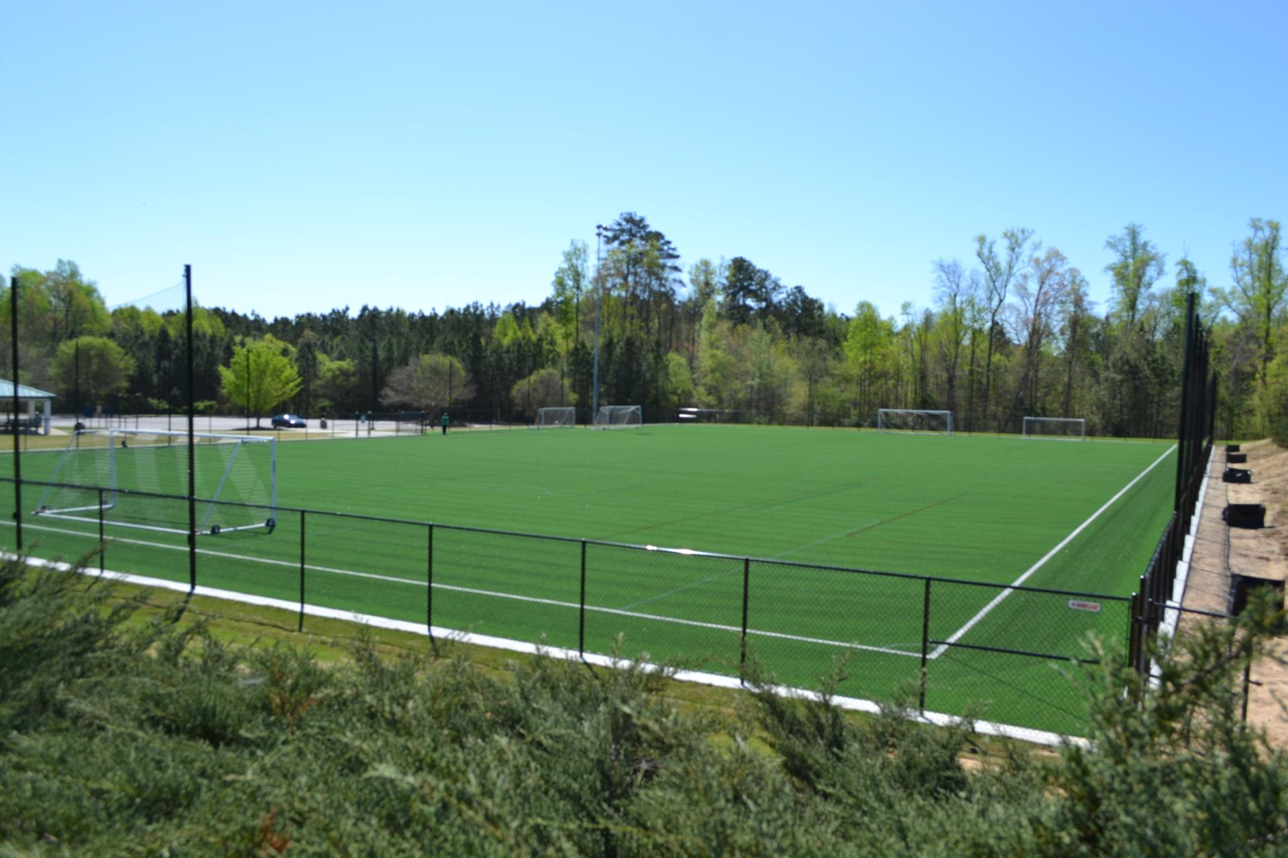
Concrete Parking Lot
Permeable Concrete
Grass
Artificial Turf
© SRI International, Digital Promise, University of Virginia, and Vanderbilt University 2022. This work is licensed under CC BY-NC-SA 4.0 license.
To view a copy of this license, visit https://creativecommons.org/licenses/by-nc-sa/4.0/

Slide 48
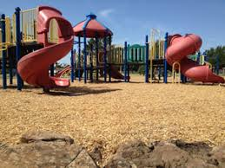
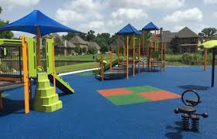
Wood Chips
Poured Rubber
© SRI International, Digital Promise, University of Virginia, and Vanderbilt University 2022. This work is licensed under CC BY-NC-SA 4.0 license.
To view a copy of this license, visit https://creativecommons.org/licenses/by-nc-sa/4.0/

Slide 49
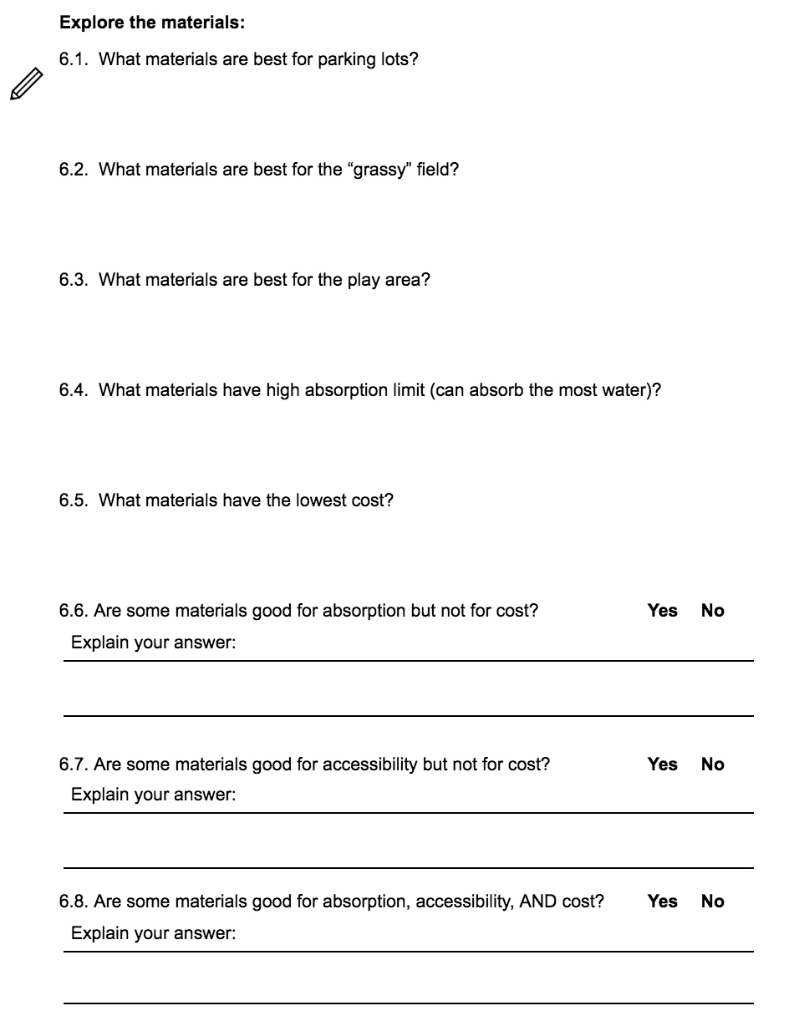
Page 22 of Student Notebook
© SRI International, Digital Promise, University of Virginia, and Vanderbilt University 2022. This work is licensed under CC BY-NC-SA 4.0 license.
To view a copy of this license, visit https://creativecommons.org/licenses/by-nc-sa/4.0/

Slide 50
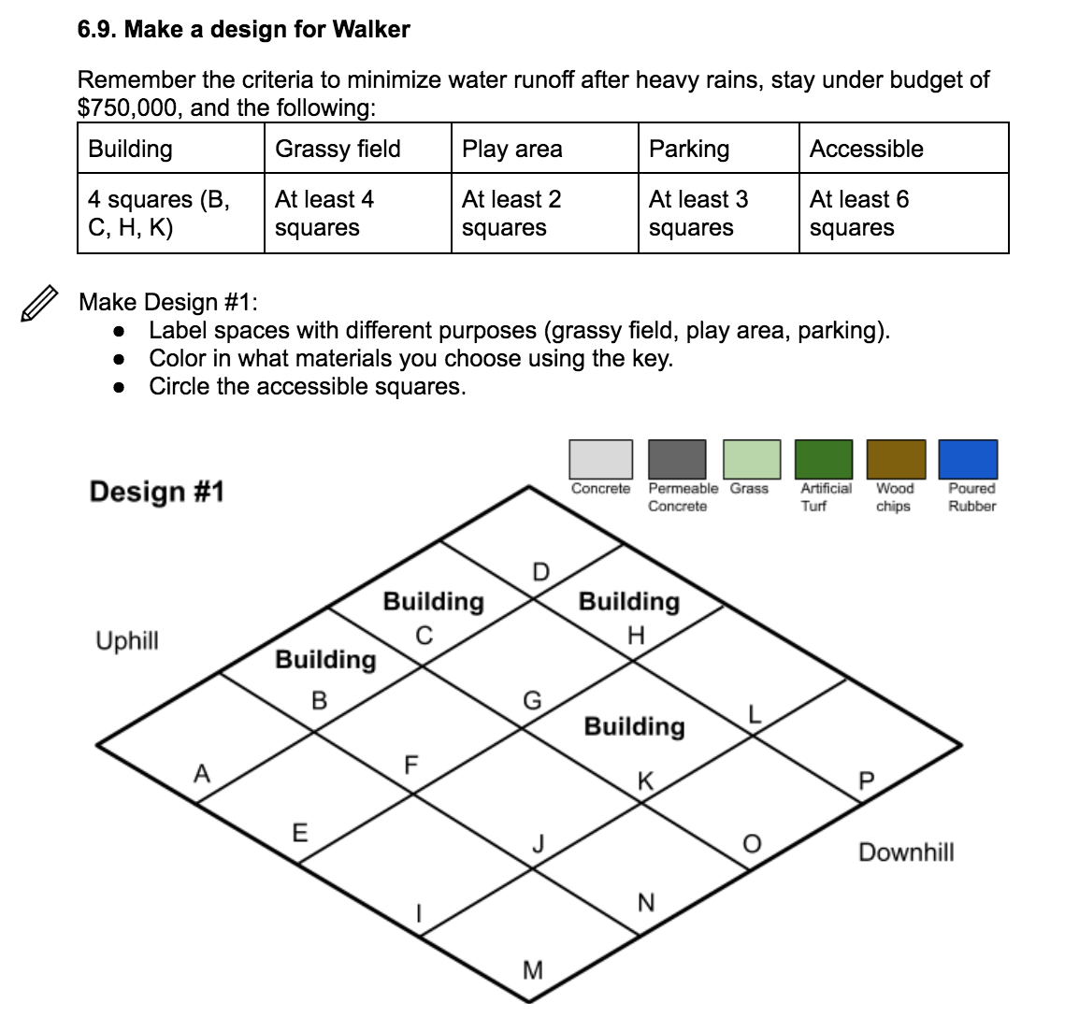
Page 23 of Student Notebook
© SRI International, Digital Promise, University of Virginia, and Vanderbilt University 2022. This work is licensed under CC BY-NC-SA 4.0 license.
To view a copy of this license, visit https://creativecommons.org/licenses/by-nc-sa/4.0/
Notes:
Should be 6.9 and 6.10

Slide 51
Walker Upper Elementary
© SRI International, Digital Promise, University of Virginia, and Vanderbilt University 2022. This work is licensed under CC BY-NC-SA 4.0 license.
To view a copy of this license, visit https://creativecommons.org/licenses/by-nc-sa/4.0/
Notes:
Generating the need for computational modeling
We need to know which design is best - should we calculate this all by hand? Or use computational modeling??

Slide 52
Closing Question: Why do we need a computer model to test our design?
© SRI International, Digital Promise, University of Virginia, and Vanderbilt University 2022. This work is licensed under CC BY-NC-SA 4.0 license.
To view a copy of this license, visit https://creativecommons.org/licenses/by-nc-sa/4.0/

Slide 53
Lesson 7:
What language does a computer understand?
© SRI International, Digital Promise, University of Virginia, and Vanderbilt University 2022. This work is licensed under CC BY-NC-SA 4.0 license.
To view a copy of this license, visit https://creativecommons.org/licenses/by-nc-sa/4.0/

Slide 54
What language does a computer understand?
© SRI International, Digital Promise, University of Virginia, and Vanderbilt University 2022. This work is licensed under CC BY-NC-SA 4.0 license.
To view a copy of this license, visit https://creativecommons.org/licenses/by-nc-sa/4.0/

Slide 55
Let’s play a game!
Everyone stand up!
For each statement I make, say if it is TRUE or FALSE.
If it is FALSE, you can sit down.
© SRI International, Digital Promise, University of Virginia, and Vanderbilt University 2022. This work is licensed under CC BY-NC-SA 4.0 license.
To view a copy of this license, visit https://creativecommons.org/licenses/by-nc-sa/4.0/

Slide 56
What language does a computer understand?
True and false are very important to computers. Computers decide what to do based on whether statements are true or false, like you did!
© SRI International, Digital Promise, University of Virginia, and Vanderbilt University 2022. This work is licensed under CC BY-NC-SA 4.0 license.
To view a copy of this license, visit https://creativecommons.org/licenses/by-nc-sa/4.0/

Slide 57
Play a dice game with a partner
We are going to use the < > = symbols to decide whether statements are true or false.
Open your notebooks and play Game Level 1. Stop when you get to Game Level 2.
Page 24 of Student Notebook
© SRI International, Digital Promise, University of Virginia, and Vanderbilt University 2022. This work is licensed under CC BY-NC-SA 4.0 license.
To view a copy of this license, visit https://creativecommons.org/licenses/by-nc-sa/4.0/

Slide 58
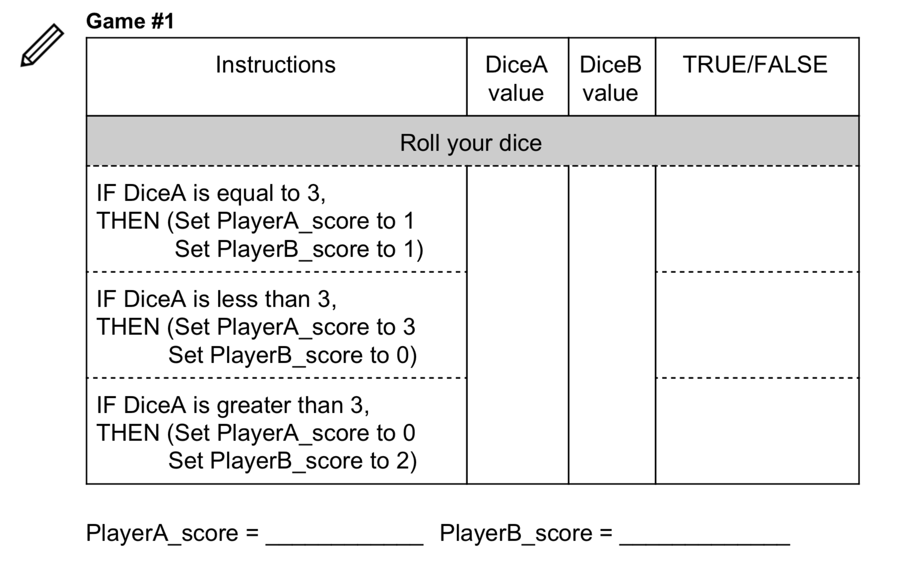
Game 1
Page 24 of Student Notebook
© SRI International, Digital Promise, University of Virginia, and Vanderbilt University 2022. This work is licensed under CC BY-NC-SA 4.0 license.
To view a copy of this license, visit https://creativecommons.org/licenses/by-nc-sa/4.0/

Slide 59
Game Level 1 Discussion
What does it mean to get Dice1 points?
What does it mean to get Dice1 + 3 points?
What does it mean to get Dice1 - Dice2 points?
© SRI International, Digital Promise, University of Virginia, and Vanderbilt University 2022. This work is licensed under CC BY-NC-SA 4.0 license.
To view a copy of this license, visit https://creativecommons.org/licenses/by-nc-sa/4.0/

Slide 60
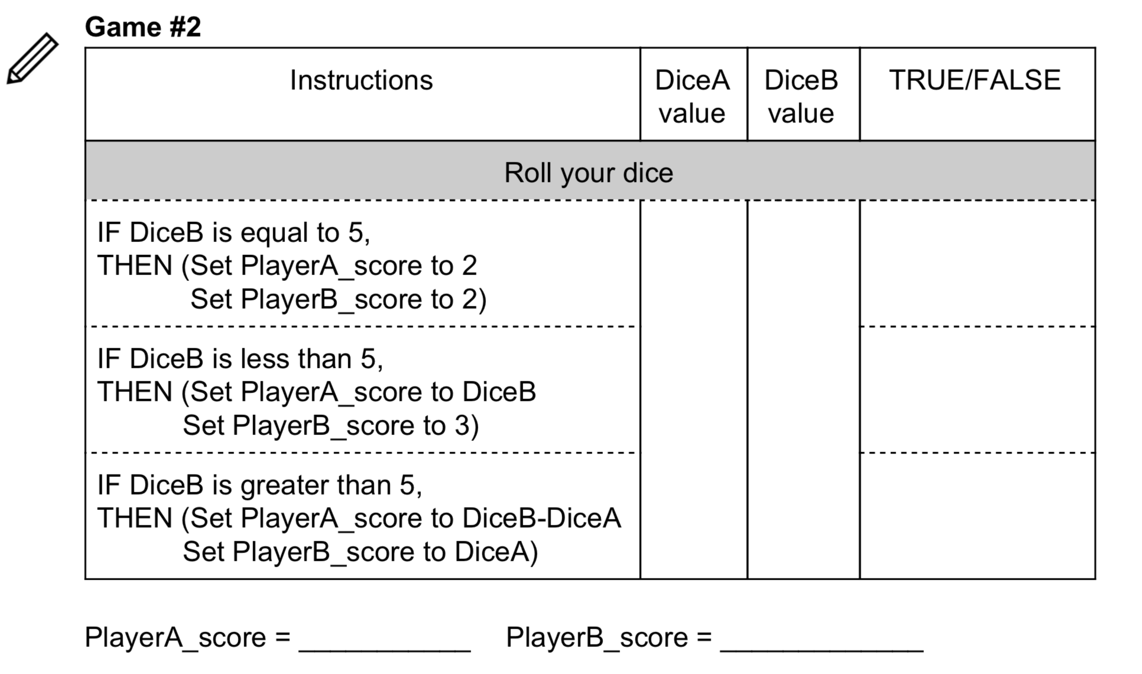
Game 2
Page 25 of Student Notebook
© SRI International, Digital Promise, University of Virginia, and Vanderbilt University 2022. This work is licensed under CC BY-NC-SA 4.0 license.
To view a copy of this license, visit https://creativecommons.org/licenses/by-nc-sa/4.0/

Slide 61
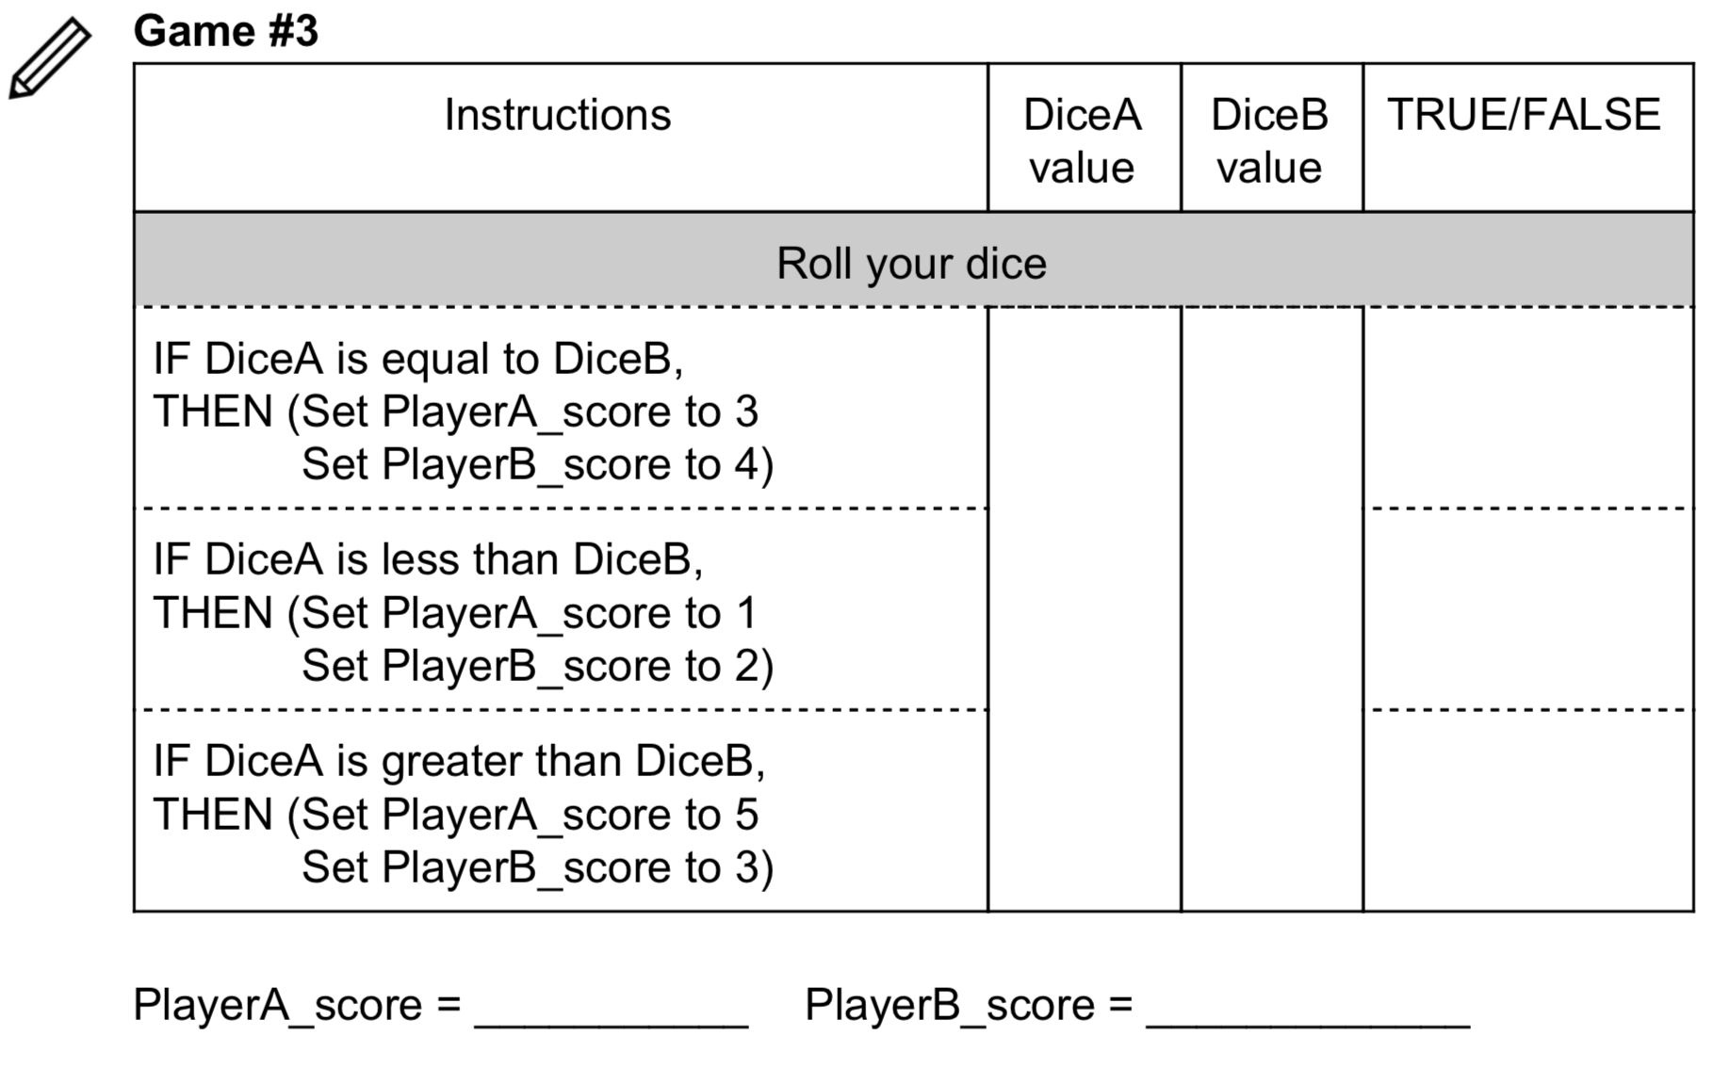
Game 3
Page 25 of Student Notebook
© SRI International, Digital Promise, University of Virginia, and Vanderbilt University 2022. This work is licensed under CC BY-NC-SA 4.0 license.
To view a copy of this license, visit https://creativecommons.org/licenses/by-nc-sa/4.0/

Slide 62
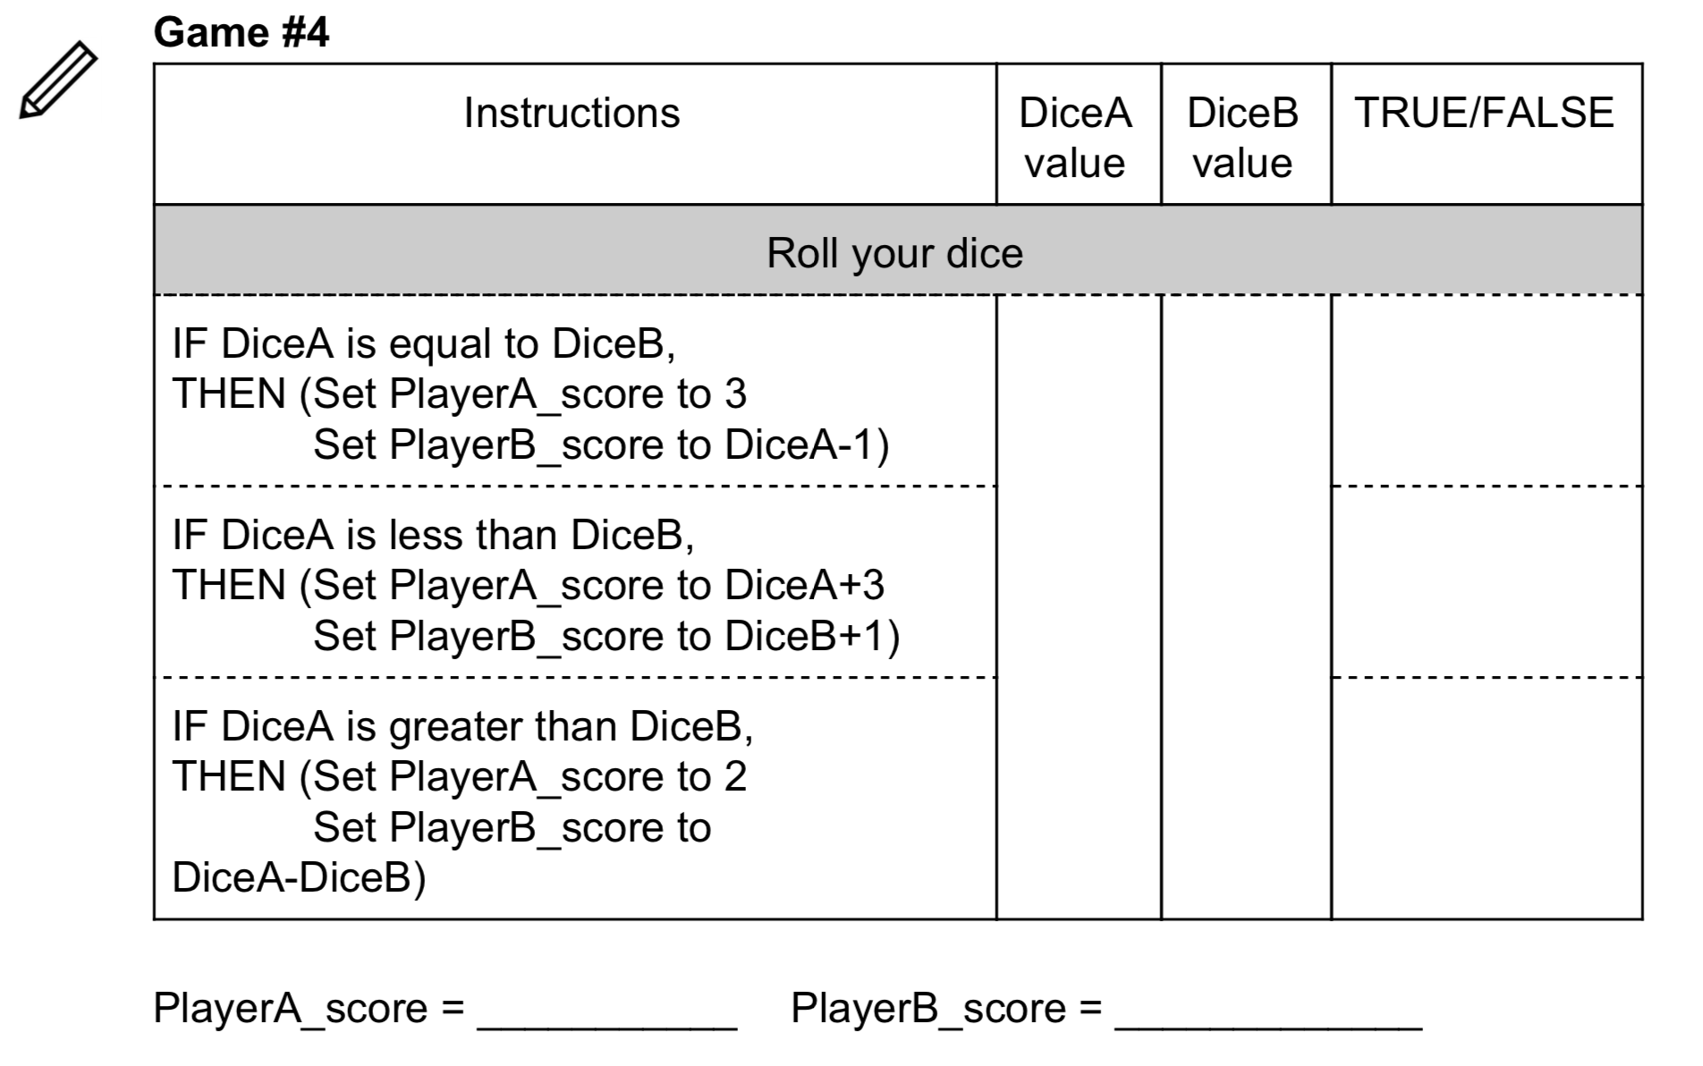
Game 4
Page 26 of Student Notebook
© SRI International, Digital Promise, University of Virginia, and Vanderbilt University 2022. This work is licensed under CC BY-NC-SA 4.0 license.
To view a copy of this license, visit https://creativecommons.org/licenses/by-nc-sa/4.0/

Slide 63
Variables and expressions
In this dice game, Dice1 and Dice2 are examples of variables​ in computer language. A variable can have different values depending on what the instructions tell the computer to do.
Words like plus (+), minus (-), or less than (<) are called operators. When you combine variables using operators, we call it an expression. Here are some examples of expressions: Dice1 + Dice2, Dice1 is less than Dice2, Dice1 – 5.
© SRI International, Digital Promise, University of Virginia, and Vanderbilt University 2022. This work is licensed under CC BY-NC-SA 4.0 license.
To view a copy of this license, visit https://creativecommons.org/licenses/by-nc-sa/4.0/

Slide 64
Play a dice game by reading code
Page 27 of Student Notebook
 | Dice variables |  | Score variables
Round | DiceA | DiceB | PlayerA score | PlayerB score
1
2
3
4
5
6
© SRI International, Digital Promise, University of Virginia, and Vanderbilt University 2022. This work is licensed under CC BY-NC-SA 4.0 license.
To view a copy of this license, visit https://creativecommons.org/licenses/by-nc-sa/4.0/

Slide 65
Challenges with Writing Instructions for Computers
The computer needs very specific instructions, usually more than you would think, to be able to run a program.
A computer does not understand English or other human languages. It only understands computer languages.
An algorithm is a precise set of instructions that solves a problem
© SRI International, Digital Promise, University of Virginia, and Vanderbilt University 2022. This work is licensed under CC BY-NC-SA 4.0 license.
To view a copy of this license, visit https://creativecommons.org/licenses/by-nc-sa/4.0/

Slide 66
Creating Computer Models
What do we want our computer models to be able to do?
What are the rules from your conceptual models (what you drew) that we need to include in our computer model?
© SRI International, Digital Promise, University of Virginia, and Vanderbilt University 2022. This work is licensed under CC BY-NC-SA 4.0 license.
To view a copy of this license, visit https://creativecommons.org/licenses/by-nc-sa/4.0/
Notes:
How is our computer model similar or different from our conceptual model?
What’s powerful about a computer model? (affordances - allowing prediction, carrying complex computation, simulation)

Slide 67
Lesson 8:
Build a computer model to calculate runoff from different surfaces (part 1)
© SRI International, Digital Promise, University of Virginia, and Vanderbilt University 2022. This work is licensed under CC BY-NC-SA 4.0 license.
To view a copy of this license, visit https://creativecommons.org/licenses/by-nc-sa/4.0/

Slide 68
Create test cases
Page 28 of Student Notebook
Test cases ​are numbers to test whether a computer program is working correctly. You can use these values to test your computer model as you build it.
Rainfall | Absorption limit (wood chips) | Absorption and runoff
1 inch | 1 inch | Absorption: __________ inches Runoff: _________ inches
0.7 inches | 1 inch | Absorption: __________ inches Runoff: _________ inches
1.4 inches | 1 inch | Absorption: __________ inches Runoff: _________ inches
© SRI International, Digital Promise, University of Virginia, and Vanderbilt University 2022. This work is licensed under CC BY-NC-SA 4.0 license.
To view a copy of this license, visit https://creativecommons.org/licenses/by-nc-sa/4.0/
Notes:
Connect variable names students suggest with variable names used in the computational model

Slide 69
Remember our models of where water goes...
Now we are going to build a computer model!
What are the two things that can happen to rainwater when it hits the surface?
If we want to model what happens to rainwater when it hits the surface, what are our inputs and what are our outputs?
© SRI International, Digital Promise, University of Virginia, and Vanderbilt University 2022. This work is licensed under CC BY-NC-SA 4.0 license.
To view a copy of this license, visit https://creativecommons.org/licenses/by-nc-sa/4.0/

Slide 70
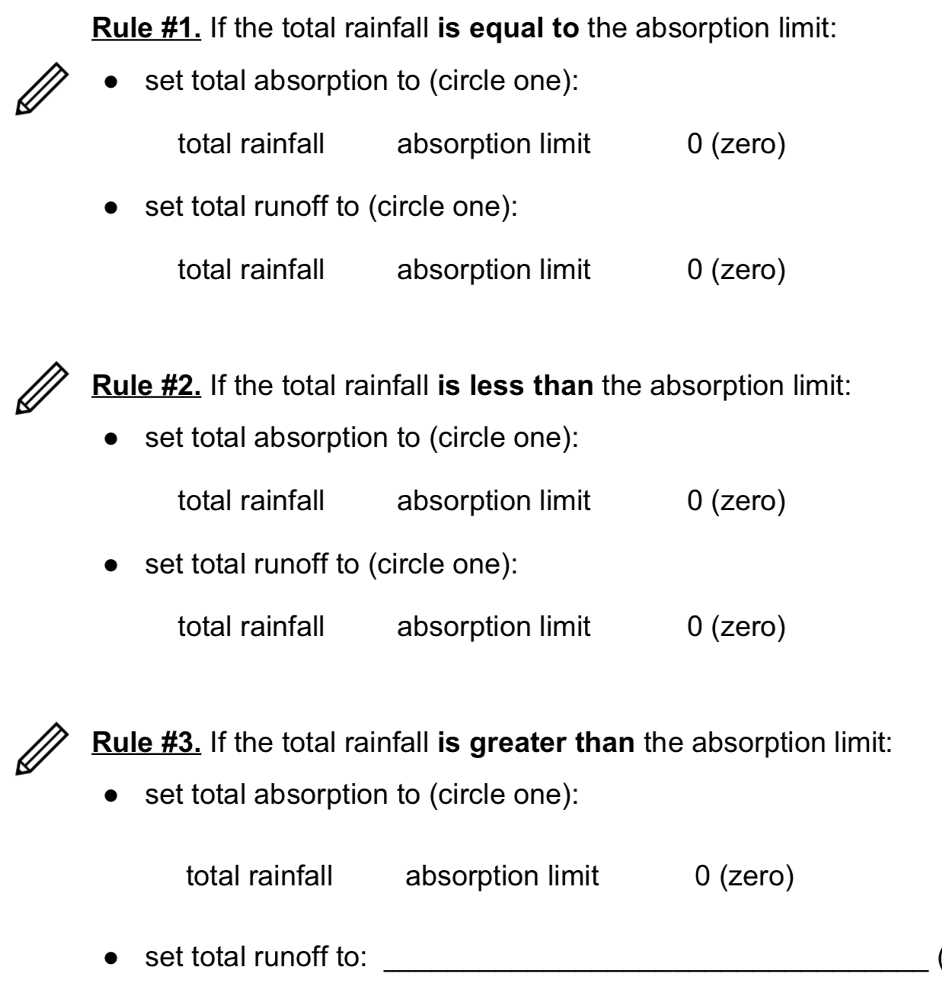
8.2. Creating Rules
Page 29 of Student Notebook
How did you figure out the absorption and runoff amounts?
© SRI International, Digital Promise, University of Virginia, and Vanderbilt University 2022. This work is licensed under CC BY-NC-SA 4.0 license.
To view a copy of this license, visit https://creativecommons.org/licenses/by-nc-sa/4.0/

Slide 71
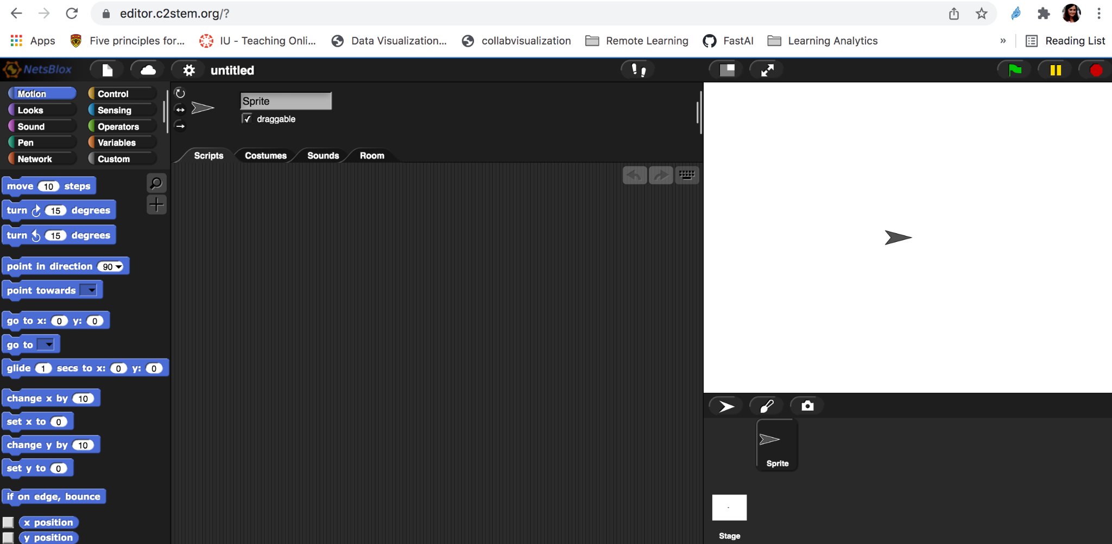
C2STEM login: https://editor.c2stem.org
Open project
Login
© SRI International, Digital Promise, University of Virginia, and Vanderbilt University 2022. This work is licensed under CC BY-NC-SA 4.0 license.
To view a copy of this license, visit https://creativecommons.org/licenses/by-nc-sa/4.0/
Notes:
https://editor.c2stem.org

Slide 72
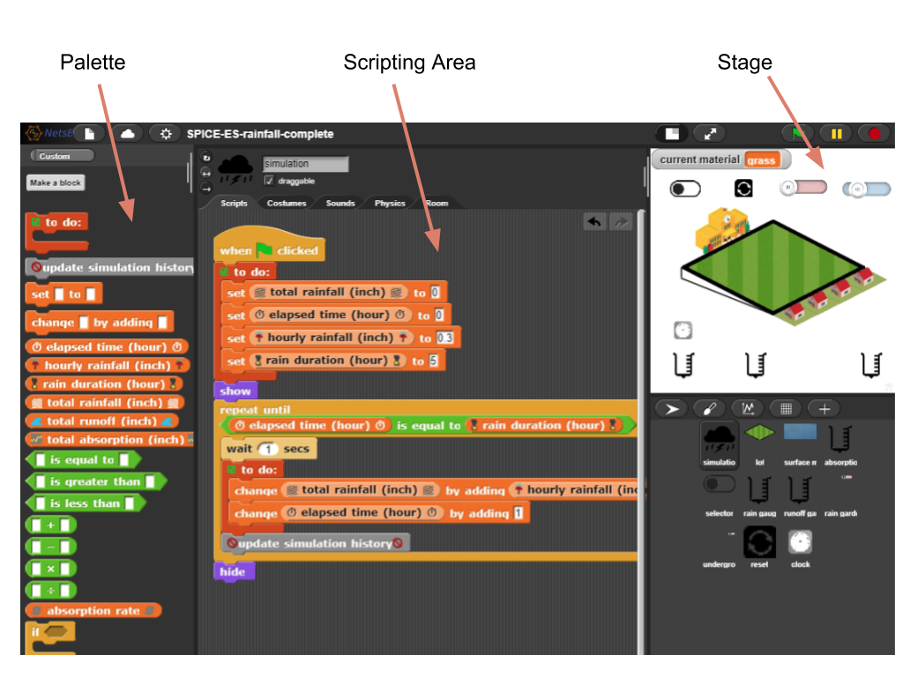
C2STEM
© SRI International, Digital Promise, University of Virginia, and Vanderbilt University 2022. This work is licensed under CC BY-NC-SA 4.0 license.
To view a copy of this license, visit https://creativecommons.org/licenses/by-nc-sa/4.0/

Slide 73
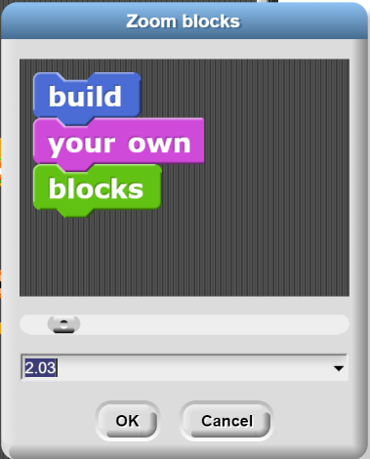
Make Blocks Bigger
© SRI International, Digital Promise, Vanderbilt University, and the University of Virginia 2022. This work is licensed under CC BY-NC-SA 4.0 license.
To view a copy of this license, visit https://creativecommons.org/licenses/by-nc-sa/4.0/

Slide 74
Starting, stopping, and pausing the simulation
Walker Water Runoff Project
These three buttons are used to start, pause, and stop the simulation. The pause button toggles between pausing and resuming the simulation. .
This button toggles between full-screen mode (only shows the stage) and full-view mode (shows everything)
© SRI International, Digital Promise, University of Virginia, and Vanderbilt University 2022. This work is licensed under CC BY-NC-SA 4.0 license.
To view a copy of this license, visit https://creativecommons.org/licenses/by-nc-sa/4.0/
Notes:
Refer to cheat sheet for more details

Slide 75
Categories of blocks
Orange blocks represent variables and help assign initial values and change rules of variables
Green blocks represent arithmetic and logical operators. Operands can be variables or constants.
When variables or variables and constants are combined using operators, it is known as an expression
Yellow blocks dictate the control of the program. For example, repetition of actions or choosing an action if a condition is true
© SRI International, Digital Promise, University of Virginia, and Vanderbilt University 2022. This work is licensed under CC BY-NC-SA 4.0 license.
To view a copy of this license, visit https://creativecommons.org/licenses/by-nc-sa/4.0/
Notes:
Use Quick Reference Sheet for C2STEM tools to introduce the environment

Slide 76
Accessing the computational model
Go to the NetsBlox Sign-in page
Enter your username and password given to you.
3. Your SPICE ID:
And the password is:
© SRI International, Digital Promise, University of Virginia, and Vanderbilt University 2022. This work is licensed under CC BY-NC-SA 4.0 license.
To view a copy of this license, visit https://creativecommons.org/licenses/by-nc-sa/4.0/

Slide 77
Don’t forget to save your model!
A good rule of thumb is to save your model when you feel you make some progress. Always save your model before the class ends.
It may take a while to complete the save. Please be patient.
© SRI International, Digital Promise, University of Virginia, and Vanderbilt University 2022. This work is licensed under CC BY-NC-SA 4.0 license.
To view a copy of this license, visit https://creativecommons.org/licenses/by-nc-sa/4.0/

Slide 78
LOGOUT after you SAVE your model
Before you close the C2STEM page, remember to log out.
This is especially important if this laptop is used by someone else! You don’t want other students messing with your computational models.
© SRI International, Digital Promise, University of Virginia, and Vanderbilt University 2022. This work is licensed under CC BY-NC-SA 4.0 license.
To view a copy of this license, visit https://creativecommons.org/licenses/by-nc-sa/4.0/

Slide 79
Page 30 of Student Notebook
© SRI International, Digital Promise, University of Virginia, and Vanderbilt University 2022. This work is licensed under CC BY-NC-SA 4.0 license.
To view a copy of this license, visit https://creativecommons.org/licenses/by-nc-sa/4.0/

Slide 80
8.4 Test your model
Page 31 of Student Notebook
Does the amount of rainfall equal the amount of water absorbed plus the amount of water runoff?
Make sure you have wood chips selected
© SRI International, Digital Promise, University of Virginia, and Vanderbilt University 2022. This work is licensed under CC BY-NC-SA 4.0 license.
To view a copy of this license, visit https://creativecommons.org/licenses/by-nc-sa/4.0/

Slide 81
Remember to SAVE YOUR WORK!!
© SRI International, Digital Promise, University of Virginia, and Vanderbilt University 2022. This work is licensed under CC BY-NC-SA 4.0 license.
To view a copy of this license, visit https://creativecommons.org/licenses/by-nc-sa/4.0/

Slide 82
Lesson 9:
Build a computer model to calculate runoff from different surfaces (part 2)
© SRI International, Digital Promise, University of Virginia, and Vanderbilt University 2022. This work is licensed under CC BY-NC-SA 4.0 license.
To view a copy of this license, visit https://creativecommons.org/licenses/by-nc-sa/4.0/

Slide 83
Fix another students’ program
Page 32 of Student Notebook
Here is a program a student wrote for Rule #1 from yesterday, but it does not give the correct results.
Mistakes in a program are called bugs. Fixing a program so that it works correctly is called debugging. Explain what is wrong with this program and how to fix it.
© SRI International, Digital Promise, University of Virginia, and Vanderbilt University 2022. This work is licensed under CC BY-NC-SA 4.0 license.
To view a copy of this license, visit https://creativecommons.org/licenses/by-nc-sa/4.0/
Notes:
Just a note: Grace Hopper and her colleagues came up with the term “debugging” - in one of the first large computers, there was actually a bug in the computer that was keeping it from working. From then on whenever they were trying to fix a program it was called “debugging”. Grace Hopper made the first compiler (instead of using 1’s and 0’s, to program computers, you can use words/functions).

Slide 84
Opening your project
Go to earth.c2stem.org and sign in
Enter your username and password.
Open your model
© SRI International, Digital Promise, University of Virginia, and Vanderbilt University 2022. This work is licensed under CC BY-NC-SA 4.0 license.
To view a copy of this license, visit https://creativecommons.org/licenses/by-nc-sa/4.0/

Slide 85
OPEN your last saved model from Lesson 8
Click on the “open” option, then look under the “Cloud” tab on the left to find your previously saved file(s). Select the file you saved yesterday and continue working.
© SRI International, Digital Promise, University of Virginia, and Vanderbilt University 2022. This work is licensed under CC BY-NC-SA 4.0 license.
To view a copy of this license, visit https://creativecommons.org/licenses/by-nc-sa/4.0/

Slide 86
Build Rule #2
Page 32 of Student Notebook
© SRI International, Digital Promise, University of Virginia, and Vanderbilt University 2022. This work is licensed under CC BY-NC-SA 4.0 license.
To view a copy of this license, visit https://creativecommons.org/licenses/by-nc-sa/4.0/

Slide 87
Page 33 of Student Notebook
© SRI International, Digital Promise, University of Virginia, and Vanderbilt University 2022. This work is licensed under CC BY-NC-SA 4.0 license.
To view a copy of this license, visit https://creativecommons.org/licenses/by-nc-sa/4.0/

Slide 88
Lesson 10:
Build a computer model to calculate runoff from different surfaces (part 3)
© SRI International, Digital Promise, University of Virginia, and Vanderbilt University 2022. This work is licensed under CC BY-NC-SA 4.0 license.
To view a copy of this license, visit https://creativecommons.org/licenses/by-nc-sa/4.0/

Slide 89
Continue building and testing (10.1-10.2)
Page 34 of Student Notebook
Go to earth.c2stem.org and sign in
Enter your username and password.
Open your model
Remember to SAVE YOUR WORK!!
© SRI International, Digital Promise, University of Virginia, and Vanderbilt University 2022. This work is licensed under CC BY-NC-SA 4.0 license.
To view a copy of this license, visit https://creativecommons.org/licenses/by-nc-sa/4.0/

Slide 90
Lesson 11:
How can we test that our design meets project criteria?
© SRI International, Digital Promise, University of Virginia, and Vanderbilt University 2022. This work is licensed under CC BY-NC-SA 4.0 license.
To view a copy of this license, visit https://creativecommons.org/licenses/by-nc-sa/4.0/

Slide 91
What can our computer model do?
What can’t our computer model do?
How can we use our models to improve our designs?
© SRI International, Digital Promise, University of Virginia, and Vanderbilt University 2022. This work is licensed under CC BY-NC-SA 4.0 license.
To view a copy of this license, visit https://creativecommons.org/licenses/by-nc-sa/4.0/

Slide 92
Page 37 of Student Notebook
© SRI International, Digital Promise, University of Virginia, and Vanderbilt University 2022. This work is licensed under CC BY-NC-SA 4.0 license.
To view a copy of this license, visit https://creativecommons.org/licenses/by-nc-sa/4.0/

Slide 93
Creating more designs
Page 38-39 of Student Notebook
Engineers create many designs before making a decision. Can you improve your design by reducing runoff? Reducing cost? Improving accessibility?
Can you think of different ways to reduce runoff?
Can you think of different ways to reduce cost?
Make at least 2 more designs in 11.4-11.7. Make sure to test them with your computer model!
© SRI International, Digital Promise, University of Virginia, and Vanderbilt University 2022. This work is licensed under CC BY-NC-SA 4.0 license.
To view a copy of this license, visit https://creativecommons.org/licenses/by-nc-sa/4.0/

Slide 94
How do we know what design will be best?
© SRI International, Digital Promise, University of Virginia, and Vanderbilt University 2022. This work is licensed under CC BY-NC-SA 4.0 license.
To view a copy of this license, visit https://creativecommons.org/licenses/by-nc-sa/4.0/

Slide 95
Lesson 12:
How do we know what design will be best?
© SRI International, Digital Promise, University of Virginia, and Vanderbilt University 2022. This work is licensed under CC BY-NC-SA 4.0 license.
To view a copy of this license, visit https://creativecommons.org/licenses/by-nc-sa/4.0/

Slide 96
How can you design a fair race?
Page 40 of Student Notebook
© SRI International, Digital Promise, University of Virginia, and Vanderbilt University 2022. This work is licensed under CC BY-NC-SA 4.0 license.
To view a copy of this license, visit https://creativecommons.org/licenses/by-nc-sa/4.0/

Slide 97
When you test 2 designs to compare them, how can you be sure the test is fair?
Page 40 of Student Notebook
© SRI International, Digital Promise, University of Virginia, and Vanderbilt University 2022. This work is licensed under CC BY-NC-SA 4.0 license.
To view a copy of this license, visit https://creativecommons.org/licenses/by-nc-sa/4.0/

Slide 98
12.2 Conduct a fair test of your 3 designs
Page 41 of Student Notebook
© SRI International, Digital Promise, University of Virginia, and Vanderbilt University 2022. This work is licensed under CC BY-NC-SA 4.0 license.
To view a copy of this license, visit https://creativecommons.org/licenses/by-nc-sa/4.0/

Slide 99
What are different ways to have a good design?
© SRI International, Digital Promise, University of Virginia, and Vanderbilt University 2022. This work is licensed under CC BY-NC-SA 4.0 license.
To view a copy of this license, visit https://creativecommons.org/licenses/by-nc-sa/4.0/

Slide 100
Lesson 13:
How can you use the model to improve your design?
© SRI International, Digital Promise, University of Virginia, and Vanderbilt University 2022. This work is licensed under CC BY-NC-SA 4.0 license.
To view a copy of this license, visit https://creativecommons.org/licenses/by-nc-sa/4.0/

Slide 101
Overview
Start with your best design from yesterday
Individually try to make it better
In your groups come up with the best design to present
At the end of today, you will have your final design that you will present to the class (and Walker)
© SRI International, Digital Promise, University of Virginia, and Vanderbilt University 2022. This work is licensed under CC BY-NC-SA 4.0 license.
To view a copy of this license, visit https://creativecommons.org/licenses/by-nc-sa/4.0/

Slide 102
Record your designs on “New and Improved” sheet
© SRI International, Digital Promise, University of Virginia, and Vanderbilt University 2022. This work is licensed under CC BY-NC-SA 4.0 license.
To view a copy of this license, visit https://creativecommons.org/licenses/by-nc-sa/4.0/

Slide 103
13.3. Finalize your design
Page 43 of Student Notebook
© SRI International, Digital Promise, University of Virginia, and Vanderbilt University 2022. This work is licensed under CC BY-NC-SA 4.0 license.
To view a copy of this license, visit https://creativecommons.org/licenses/by-nc-sa/4.0/

Slide 104
Lesson 14:
How can you convince the Principal at Walker to use your design?
© SRI International, Digital Promise, University of Virginia, and Vanderbilt University 2022. This work is licensed under CC BY-NC-SA 4.0 license.
To view a copy of this license, visit https://creativecommons.org/licenses/by-nc-sa/4.0/

Slide 105
What makes a good presentation?
© SRI International, Digital Promise, University of Virginia, and Vanderbilt University 2022. This work is licensed under CC BY-NC-SA 4.0 license.
To view a copy of this license, visit https://creativecommons.org/licenses/by-nc-sa/4.0/

Slide 106
Presentation
Rubrics
© SRI International, Digital Promise, University of Virginia, and Vanderbilt University 2022. This work is licensed under CC BY-NC-SA 4.0 license.
To view a copy of this license, visit https://creativecommons.org/licenses/by-nc-sa/4.0/

Slide 107
Create your presentation
Using the template (google doc, google slide), show:
The problem
Your design with evidence
Why your design is better than others
Why the Principal should choose your design
You will have 5 minutes to present your design.
Don’t forget to practice within your group!
© SRI International, Digital Promise, University of Virginia, and Vanderbilt University 2022. This work is licensed under CC BY-NC-SA 4.0 license.
To view a copy of this license, visit https://creativecommons.org/licenses/by-nc-sa/4.0/

Slide 108
Lesson 15:
Final Presentations
© SRI International, Digital Promise, University of Virginia, and Vanderbilt University 2022. This work is licensed under CC BY-NC-SA 4.0 license.
To view a copy of this license, visit https://creativecommons.org/licenses/by-nc-sa/4.0/

